Slide 1
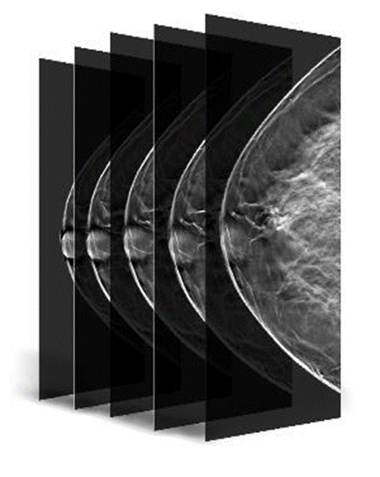

Breast Tomosynthesis and Hologic Genius™ 3D MAMMOGRAPHY™ exams
Notes:
Title slide: an introduction to genius™ 3D MAMMOGRAPHY™
PRE-00370

Slide 2
Terminology
Genius™ 3D MAMMOGRAPHY™ exam
A 2-view exam made possible only with the Hologic Selenia® Dimensions® system
Combo mode
Hologic exclusive mode that takes co-registered 2D and tomosynthesis images under one compression
Hologic low dose 3D MAMMOGRAPHY™ exam
Hologic’s unique low dose 2-view exam made possible with the Hologic Selenia® Dimensions® system and the C-View™ software option
also known as TomoHD mode
Notes:
Terminology slide – share with audience the current terminology used with Hologic’s tomosynthesis product

Slide 3
Overview
2D mammography challenges & limitations
Why perform Genius™ 3D MAMMOGRAPHY™ exams?
The technology behind Genius™ 3D MAMMOGRAPHY™ exam
3D MAMMOGRAPHY™ exam clinical performance?
Generating a 2D image with C-View™ software
Clinical examples
Notes:
This presentation will give an overview of the following areas:
The challenges with 2D imaging
Why perform Genius™ 3D MAMMOGRAPHY™ exams?
Hologic’s technology & technique
Creating a 2D image through C-View™ software
How is it used clinically with sharing examples
What is the clinical performance?
And a summary of advantages

Slide 4
Challenges of conventional mammography
Prompt annual mammography has shown the ability to reduce the mortality rate from breast cancer in a population by 15% to 50% ¹⁻³
As many as 20% of breast cancers will be missed by conventional mammography ⁴
In the U.S. ~10% of women are recalled for additional diagnostic work-up
A significant portion prove to have no abnormality, resulting in unnecessary anxiety and cost ⁵
Smith RA, Duffy SW, Gabe R et al. The randomized trials of breast cancer screening: what have we learned? Radiol Clin N Am 42 (2004) 793 – 806.
Hendrick RE, Smith RA, Rutledge JH, Smart CR. Benefit of screening mammography in women ages 40-49: a new meta-analysis of randomized controlled trials. Monogr Natl Cancer Inst 1997;22:87-92.
Tabar L, Vitak B, Tony HH, Yen MF, Duffy SW, Smith RA. Beyond randomized controlled trials: organized mammographic screening substantially reduces breast carcinoma mortality. Cancer 2001;91:1724-31.
http://www.cancer.gov/cancertopics/factsheet/detection/mammograms
http://radiology.rsna.org/content/244/2/381.full#T3
Notes:
2D mammography has limitations:
Screening mammography reduce the mortality rate: 15 to 50%
20% of breast cancers will be missed though
Recall rates are ~ 10%

Slide 5
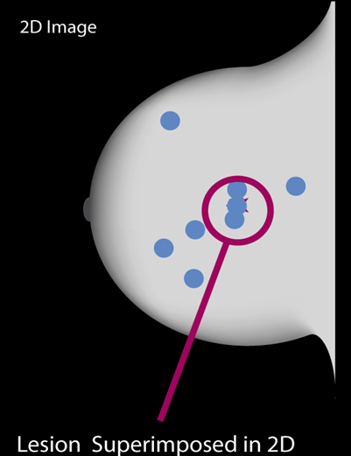
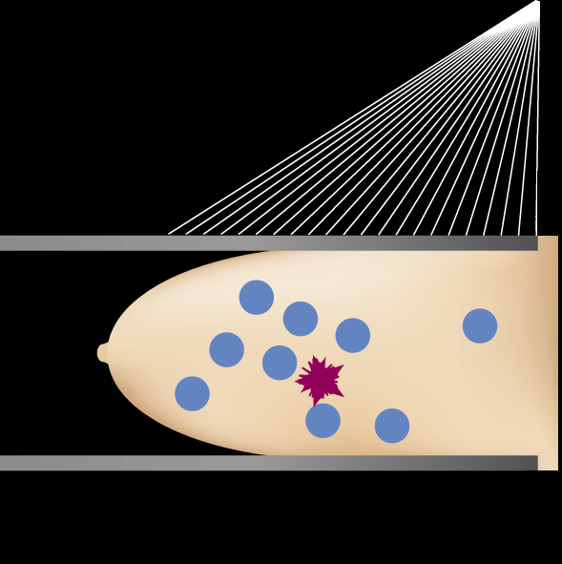
2D FFDM imaging
Tissue superimposition hides or mimics pathologies in 2D
Notes:
A major factor contributing to the limited performance of 2D full field digital mammography is the tissue superimposition that is created by the overlap of normal breast structures in a two-dimensional mammographic projection
Click x 2
These overlapping structures can obscure a lesion making it more difficult to perceive or rendering it completely mammographically occult
click
Superimposition can hide or mimic pathology
Tissue superimposition hides pathologies in 2D
Tissue superimposition mimics pathologies in 2D

Slide 6
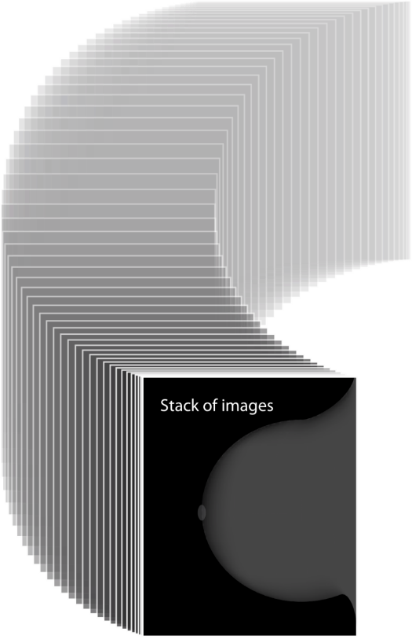
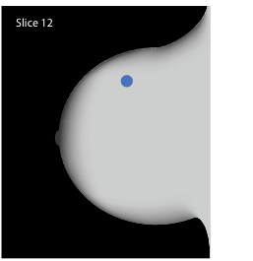
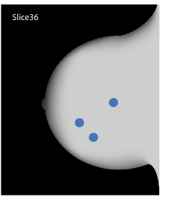
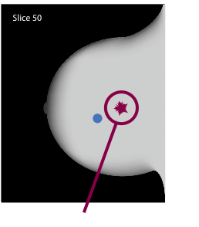
Breast Tomosynthesis Improves Visibility by Reducing Tissue Superimposition
Notes:
Click x 3 to demonstrate slices
With tomosynthesis, the radiologist is able to view the breast in 1 mm thick reconstructed slices
The slices allow improved visibility of all the breast structures

Slide 7


3D MAMMOGRAPHY™ exam Principle of Operation
X-ray tube moves in an arc across the breast
A series of low dose images are acquired from different angles
Total dose approximately the same as one 2D mammogram
Projection images are reconstructed into 1 mm slices
X-ray tube arc of motion
{
Compression Paddle
Reconstructed Slices
Compressed Breast
Detector Housing
Notes:
The x-ray tube moves in a 15 degree arc
15 low dose images are acquired – these are the projection images
Dose is equal to a single 2D mammogram
Reconstructed slices are 1 mm in thickness

Slide 8
Why combine tomosynthesis and 2D images?
Comparison of current images with prior images is standard mammography practice and critical to perceive subtle changes that may be associated with a cancer
Obtaining a 2D exam with the tomosynthesis exam will allow direct comparison of current 2D images with prior 2D images
Segmental and clustered calcifications are more easily and quickly appreciated with 2D because they can traverse multiple slices in the tomosynthesis image set
By minimizing structure overlap, tomosynthesis image slices optimally demonstrates masses and architectural distortion
Notes:
In reading mammograms we're looking for specific lesions, in particular, masses, architectural distortion, and calcifications. Because individual calcifications may be depicted on multiple slices in the three-dimensional study, they're sometimes better and more quickly appreciated on the two-dimensional projection image. On the other hand, by minimizing structure overlap, masses and architectural distortion are actually better depicted on the three-dimensional study. So we can see that the two-dimensional and three-dimensional modalities actually complement each other in mammographic interpretation.

Slide 9
Genius™ 3D MAMMOGRAPHY™ exams improve clinical outcomes
Over 40% more invasive cancer detection versus 2D²⁻⁷
Earlier detection
15-40% fewer recalls depending on practices^{2,5,8}
Reduced recalls
PPV increase of 49% for recalls and 21% biopsies²
Improved efficiencies
Study exclusively used the Hologic Selenia Dimensions system. Results are not applicable to other breast tomosynthesis systems.
Notes:
In reading mammograms we're looking for specific lesions, in particular, masses, architectural distortion, and calcifications. Because individual calcifications may be depicted on multiple slices in the three-dimensional study, they're sometimes better and more quickly appreciated on the two-dimensional projection image. On the other hand, by minimizing structure overlap, masses and architectural distortion are actually better depicted on the three-dimensional study. So we can see that the two-dimensional and three-dimensional modalities actually complement each other in mammographic interpretation.
This slide indicates the results of recent publications that have shown that screening with the addition of tomo has found 40% more invasive cancers than 2D alone. Sites are reporting in publications a reduction in recall rates of 20-40% depending on their practice, and that tomo is helping to better visualize masses, distortions and asymmetric densities.

Slide 10
A landmark study in JAMA – June 2014
454,850 examinations from 13 centers interpreted by 139 radiologists over two time periods were retrospectively analyzed²
15%
29%
41%
Notes:
In 2014, the Journal of the American Medical Association, published the results of a multi-center study.
Over 454,000 exams were performed with 139 radiologists reviewing these cases.
As you can see by the charts, 3D MAMMOGRAPHY™ exams demonstrated an increase in cancer detection rates (click x 4) with (CLICK x 2) a decrease in patient recalls.

Slide 11
A landmark study in JAMA – June 2014
 | 2D | 2D + 3D™ exams | Relative Change | P-Value
PPV for Recall | 4.3% | 6.4% | +49% | P<.001
PPV for Biopsy | 24.2% | 29.2% | +21% | P<.001
Notes:
This chart reveals the results for the PPV for recall and biopsy.

Slide 12
Benefits of a Genius™ 3D MAMMOGRAPHY™ Exam*
Most accurate mammogram available today²⁻³
Superior to 2D mammography alone^{2-3,11}
Significant increase in efficiencies⁵
Fewer false positives may result in fewer biopsies^{2,9}
Significant increase in sensitivity and specificity²⁻³
Reduced healthcare costs¹⁴
Reduction in patient anxiety and burden¹⁵
*Studies exclusively used the Hologic Selenia® Dimensions® system. Results are not applicable to other tomosynthesis mammography exams or systems.
Notes:
Click x 7 to display all bullet points
PPV - the proportion of positive screening mammograms from which cancer was diagnosed

Slide 13
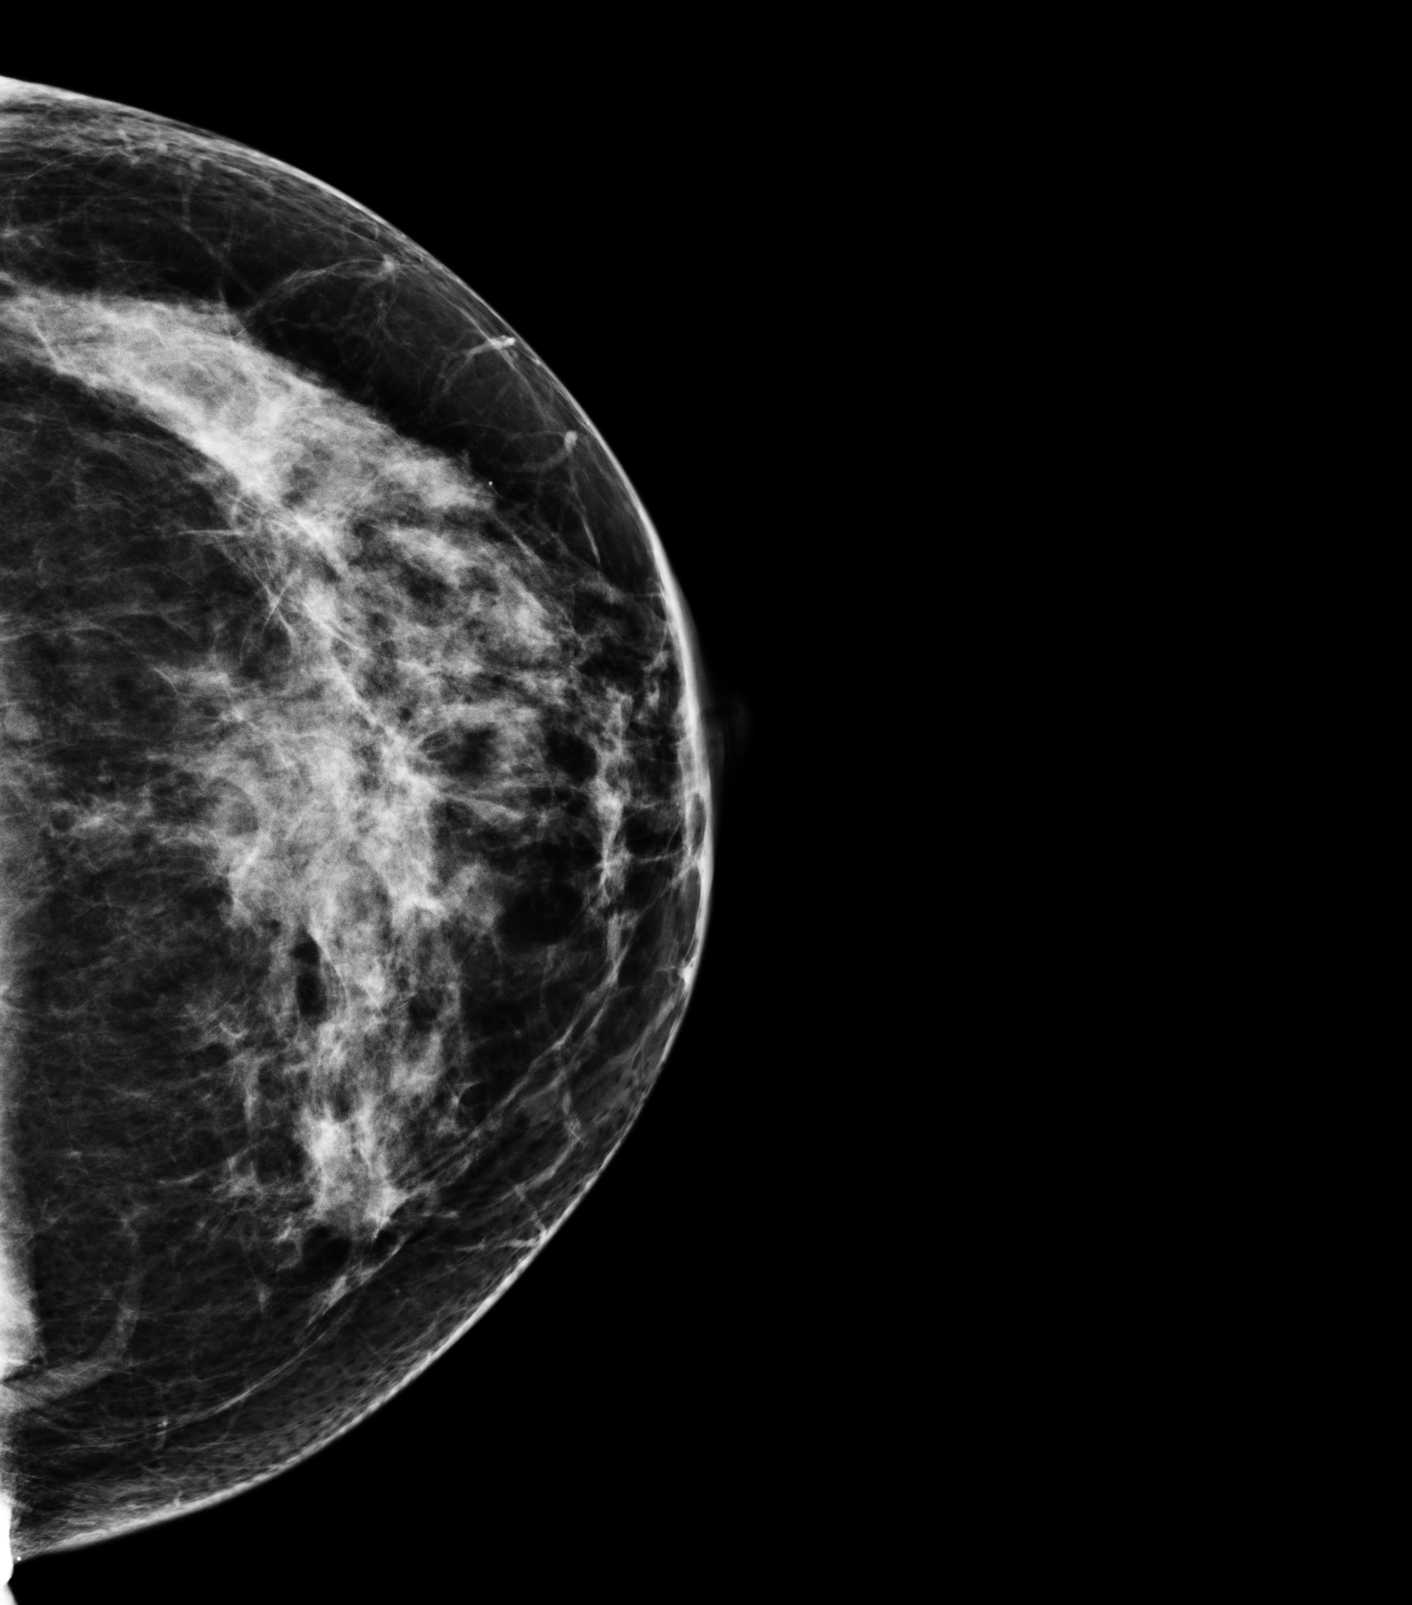
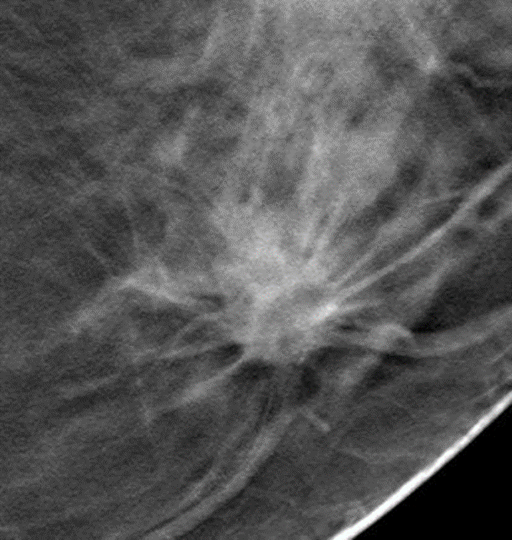
LCC
Breast cancer screening with the 3D™ exam in two views finds more cancers than in one-view ^{15,16}
2D
3D™
Notes:
Performing 2 views of the breast is still the standard of care. A CC view is still beneficial.
Here’s an example: Left CC 2D image – patient was recalled for Left medial mass; a 3D™ study was performed: here is a single tomo slice of the suspicious area – click to display enlarged image of 3D slice
Invasive Ductal Carcinoma on bx

Slide 14
Image Acquisition: Two methods
TomoHD mode
Single exposure to acquire 3D™ data set
Utilizes C-View™ software to create the 2D image
Combo mode exam
Combination of 3D™ and 2D exposures
Notes:
There are two methods for acquiring the 3D™ and 2D data.
The first method is TomoHD mode which entails a single 3D™ exposure and then utilizes the C-View software to generate the 2D image.
The second type of acquisition is the combo mode. It is two exposures under a single compression.
Let me explain in detail.
Go to next slides.

Slide 15
A short video demonstrating a patient examination

Slide 16

Notes:
Video explains TomoHD (3D™ with C-View) and combo exam (3D™ + 2D)
Click on center in slide show mode to run tomo exam file
Tomo combo exam.wmv

Slide 17
Hologic low dose 3D MAMMOGRAPHY™ exam (TomoHD mode)
C-View™ algorithm creates 2D images with important tomosynthesis information
Eliminates 2D exposures resulting in less patient dose
Greater patient comfort via fast, <4 second scan time
Generated 2D images display the heightened detail from the tomosynthesis images
Clinical evidence shows TomoHD mode is superior to 2D mammography, offering comparable clinical performance to combo mode^{1, 12-13}
Notes:
In this presentation I will share with you how the C-View™ software is utilized with tomosynthesis to generate a 2D image.
The reconstructed 2D images must be reviewed with the accompanying tomosynthesis images to make a clinical decision or diagnosis.
The benefits are a reduction in patient dose
An increase in patient comfort due to a fast 4 second scan time
The generated 2D image maintains heightened detail from the tomosynthesis images
And it was proven to have a superior performance compared to FFDM alone in a Hologic reader study (FDA PMA submission P080003/S001)
CLICK 4 times to display bullets

Slide 18


Hologic C-View™ software: generated 2D image
Perform a standard tomosynthesis scan*
3.7 seconds
*Scan time is reduced from ~10 seconds (combo mode) regardless of breast size. A short scan time lessens patient motion risk.
Notes:
The first step to generating a 2D image is to perform the 3D™ scan
Click to display bullet & motion of x-ray tube
The image represents the x-ray tube moving to produce 15 low-dose projection images.

Slide 19
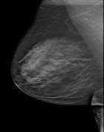

Generating 2D images
Tomosynthesis Slices
Perform a standard tomosynthesis scan
Reconstruct tomosynthesis slices
Tomosynthesis
Reconstruction Algorithm
15 Projection Images
Notes:
After the acquired scan, the projection images will be reconstructed into 1 mm slices. There are an additional 5 slices reconstructed due to paddle tilt.
Click to display up arrow & bullet

Slide 20

Generating 2D Images
Tomosynthesis Slices
Perform a standard tomosynthesis scan
Reconstruct tomosynthesis slices
Generate 2D image
Tomo + generated 2D = a low dose examination
Available in any tomosynthesis view
C-View
Software
Algorithm
Generated 2D Images
Notes:
From the reconstructed slices, a software algorithm is applied and it creates the Generated 2D image
Click to display down arrow & bullets

Slide 21
C-View™ 2D Image Attributes
Resolution
Contrast: More value/weight on linear structures and bright spots (when present)
Spatial: Reflects tomosynthesis 100$µ$m
Spatial: Reflects tomosynthesis 100µm
Normal tissue density
Less value/weight on normal tissue; less overlap while retaining density assessment ability
Skin line appearance
More akin to tomosynthesis versus FFDM
Total patient radiation dose
TomoHD mode: 1.45 mGy vs. combo mode: 2.65 mGy*
*Based on 4.5 cm compressed breast.
21
Notes:
The difference can manifest itself as a difference in the appearance of fibroglandular tissue in addition to the difference due to the enhancement of linear and calcification-like structures.
The C-View™ algorithm values the importance of contrast resolution higher than spatial resolution, not dissimilar to the design goals of CT versus an x-ray radiograph.

Slide 22
Clinical Performance: Low dose Genius™ 3D MAMMOGRAPHY™ exam vs. 2D alone^{1, 12-13}
Superior diagnostic accuracy for all breast types
Fewer non-cancer recalls
Increase in
cancer detection
Recall rate reduction
Notes:
Hologic’s clinical study shows that 3D™ mammogram + a generated 2D image is superior to 2D alone. The results demonstrate that there is a significant benefit in using Generated 2D plus tomosynthesis imaging for routine screening mammography. Diagnostic accuracy was shown to increase while non-cancer recall rate was shown to decrease with Generated 2D plus tomosynthesis compared to 2D imaging alone.

Slide 23
C-View™ 2D Image Uses
Diagnostic image replacement to FFDM within the tomosynthesis screening exam
Calcification detection and distribution
Side by side symmetry
Interval comparison
Navigation aid to the tomosynthesis image review
Must always review the tomosynthesis slices
23

Slide 24
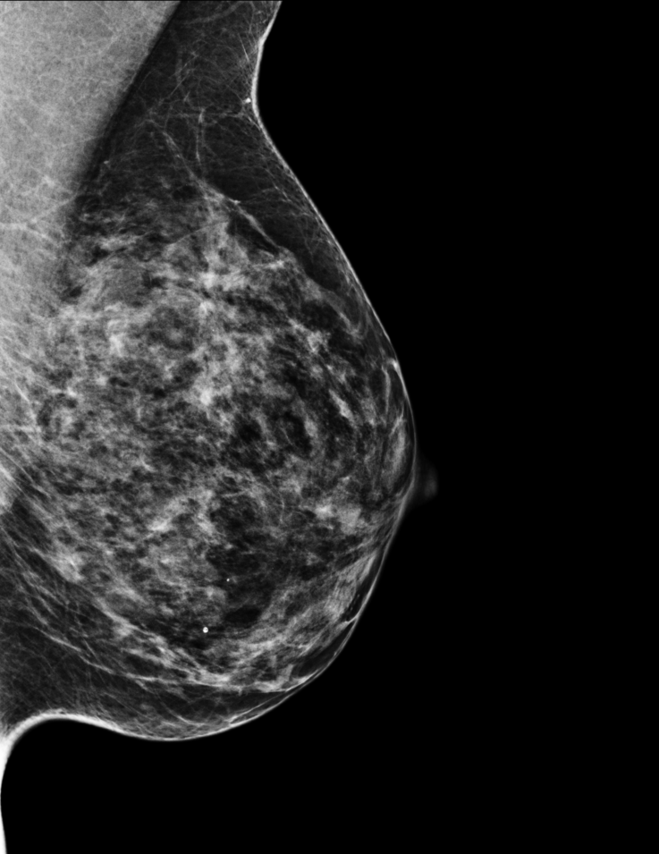
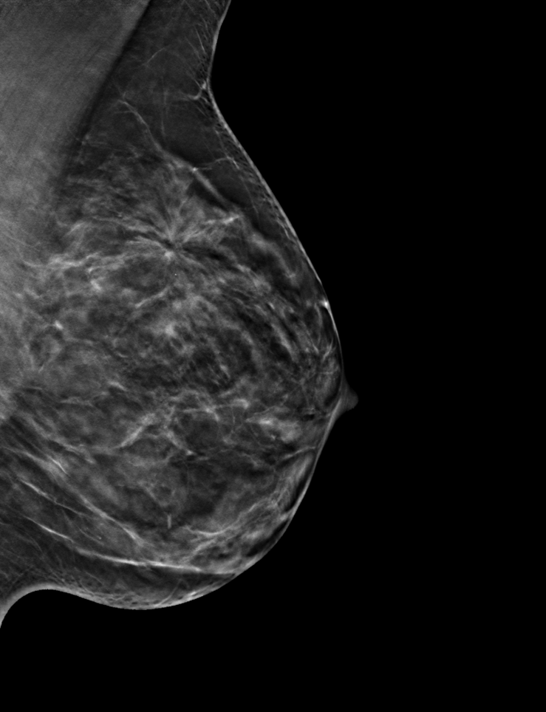
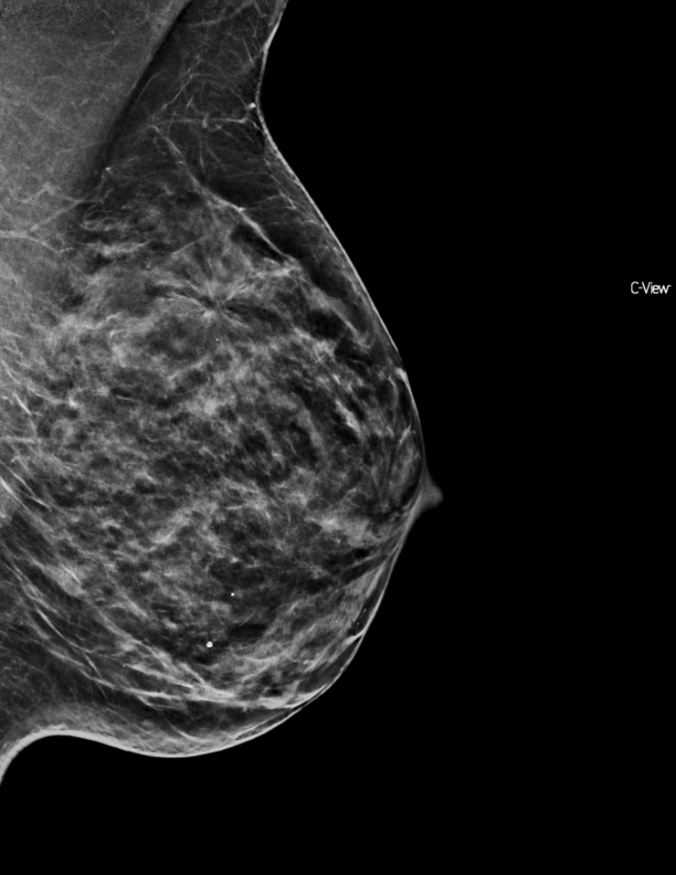
Image Comparison
FFDM 2D
Tomosynthesis Slice
C-View™ image
Notes:
Case 1: 51 y/o woman presented for routine screening mammography. The 2D mammogram is essentially negative. The tomosynthesis slices reveal an architectural distortion highly suspicious for cancer. The C-View image, reveals the architectural distortion, as well, because it is created from the combined tomosynthesis slices

Slide 25
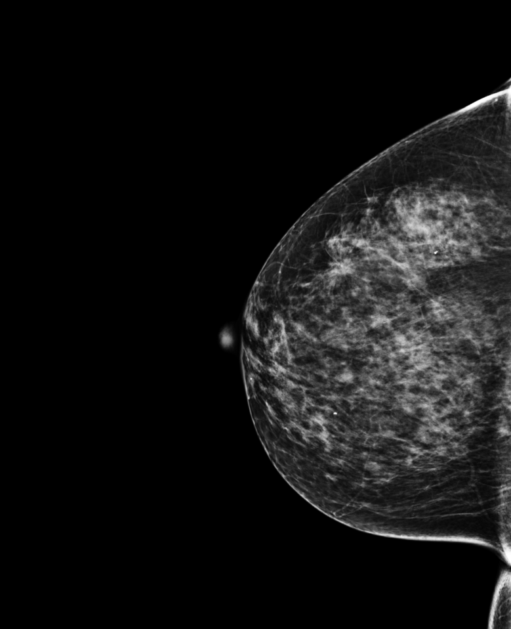
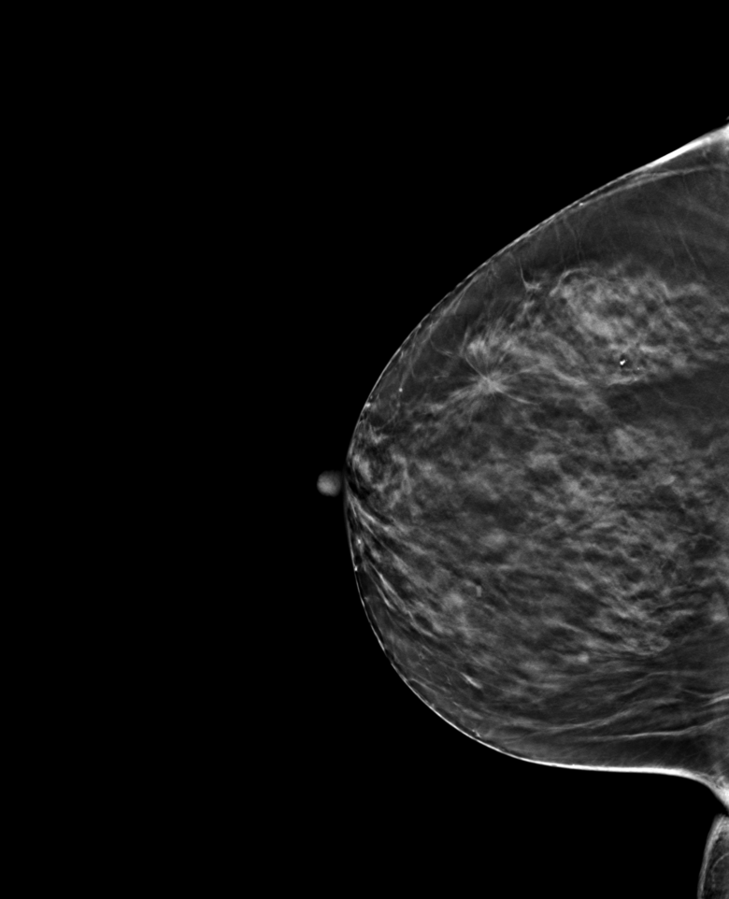
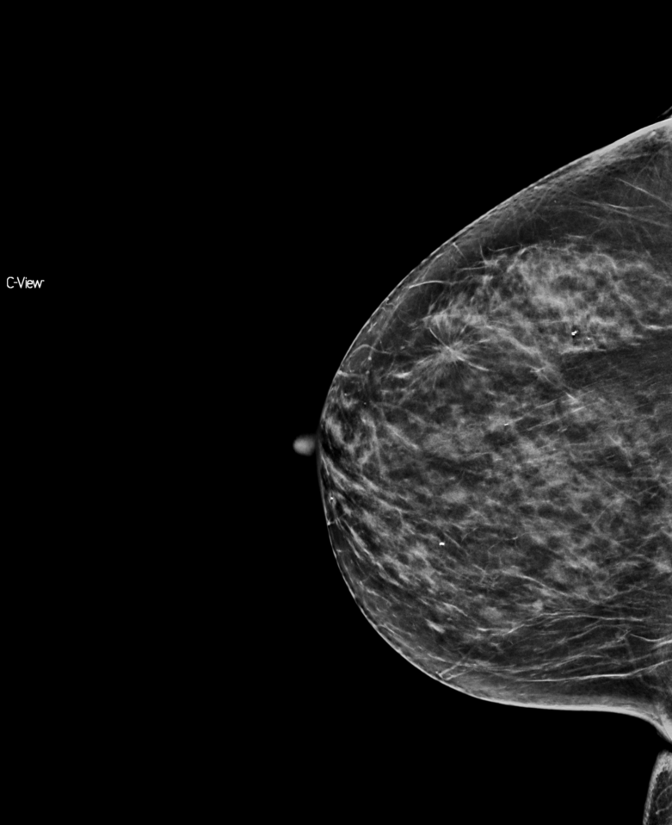
Image Comparison
FFDM 2D
Tomosynthesis Slice
C-View™ image
Notes:
Case 2: 62 y/o woman presented for routine screening mammography. The 2D mammogram reveals an inconclusive asymmetric density. The tomosynthesis slices reveal a spiculated mass, highly suspicious for cancer. The C-View image, reveals the spiculated mass because it is created from the combined tomosynthesis slices

Slide 26
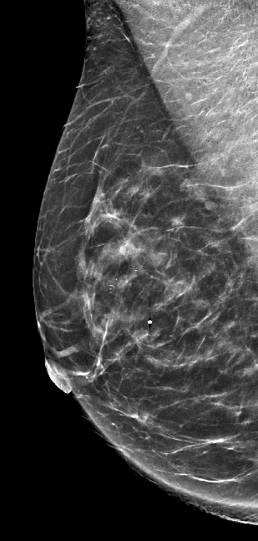
Summary: Low dose Genius™ 3D MAMMOGRAPHY™ exam¹
Lower patient dose
Shorter compression time
Increased patient comfort
Lowered risk of patient motion
Superior performance compared to traditional 2D alone^{1, 12-13}
Notes:
I have shared with you the latest technology that is available to accompany digital breast tomosynthesis.
Through the use of software to produce a generated 2D image, the images offer:
Less patient dose through reduced x-ray exposures
Shorter scan time reduces risk of patient motion and improves patient comfort compared to combo mode
And the results are superior performance compared to traditional 2D alone
Thank you for your attention, are there any questions?

Slide 27
Combo Mode examination
Notes:
There is one more available acquisition mode; it is combo mode.
This acquisition mode combines the 3D™ scan with the conventional 2D FFDM exposure all under one compression.

Slide 28
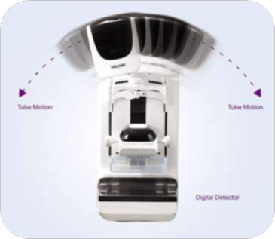
Combo Mode
A series of projection images are acquired across 15 degrees (3.7 seconds)
Tube head returns to center; a 2D image is acquired under the same compression, giving perfectly co-registered 2D & breast tomosynthesis images (~6 seconds)
The Genius™ 3D MAMMOGRAPHY™ exam is ~10 seconds total
Total dose for both 2D and the 3D™ scan is below the MQSA/EUREF limits
Two exposures under a single compression
Notes:
In combo-mode, 15 tomosynthesis projection images are acquired first within 3.7 seconds
Following tomo acquisition, the HTC grid automatically engages and a conventional 2D image is acquired under the same compression
2D and tomo images are perfectly co-registered because they are acquired in the same compression geometry
Total acquisition time/image is 10-12 seconds

Slide 29
Positioning & Compression for Combo Mode examination
Standard positioning & compression
3D™ = 15 low dose images are acquired from different angles - no grid
2D = grid is automatically brought back into place & the 2D image is acquired
Notes:
It is still the standard positioning & compression
Combo mode:
3D™ acquisition = Multiple low dose images are acquired from different angles, without the grid
2D = The grid is automatically brought back into place and a 2D mammogram is obtained

Slide 30
Clinical image review
Genius™ 3D MAMMOGRAPHY™ exams are revolutionizing breast imaging
Notes:
Here are a few examples of tomosynthesis studies

Slide 31
Clinical Study: Cancer Case 1
Patient presented with area of thickening
Several suspicious areas
Multifocality clearly seen with tomosynthesis
Pathology: Invasive ductal carcinoma and infiltrating lobular carcinoma

Slide 32
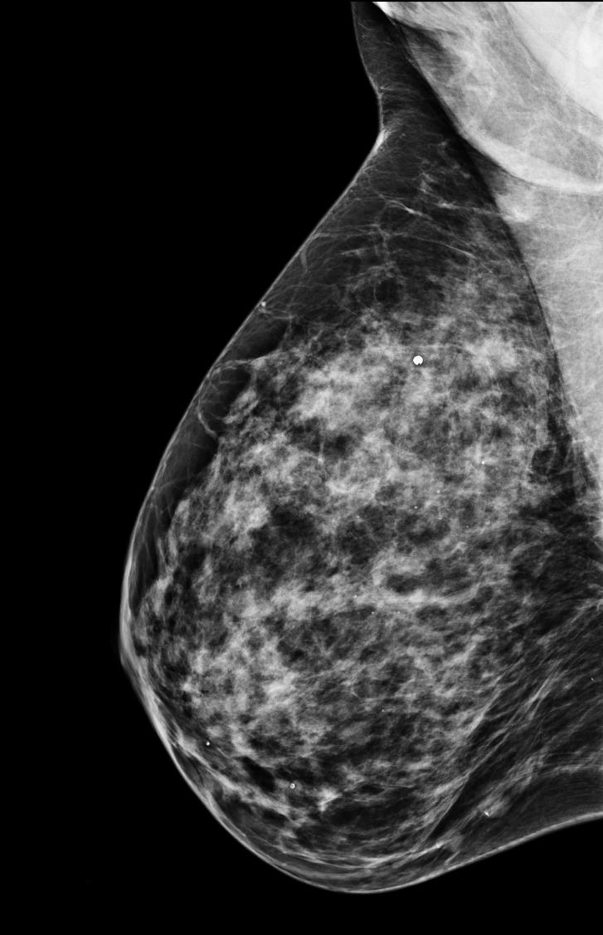
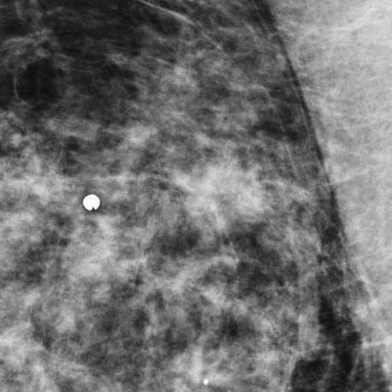
Cancer Case 1
RMLO
2D
Notes:
Cancer Case 1
(no moving image in this slide)
This patient presented with a lump for evaluation. Note the metal BB.

Slide 33
Cancer Case 1
2D
Notes:
Cancer Case 1
8503508 101-T858 (no moving image in this slide)
Here we can see the BB denoting the lump in an area of asymmetry underneath the BB. Here on the two-dimensional image it’s hard to assess the margins of this possible lesion.

Slide 34
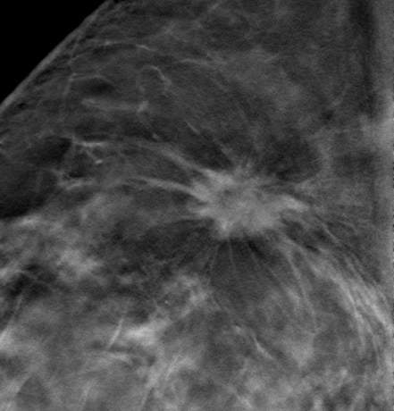
Cancer Case 1
2D
Tomosynthesis slice
Notes:
Cancer Case 1
8503508 101-T858 (no moving image in this slide)
But on the single slice from the tomosynthesis imaging, (CLICK to display tomosynthesis image) again we see the spiculated margins, conveying to us that this is almost certainly an invasive ductal carcinoma.

Slide 35
Clinical Study: Cancer Case 2
Routine screening with combo mode
2D mammogram essentially negative
Tomosynthesis RMLO reveals an area of architectural distortion in the superior aspect
2D diagnostic views added no useful information and did not reveal the lesion
Pathology: Invasive ductal carcinoma

Slide 36
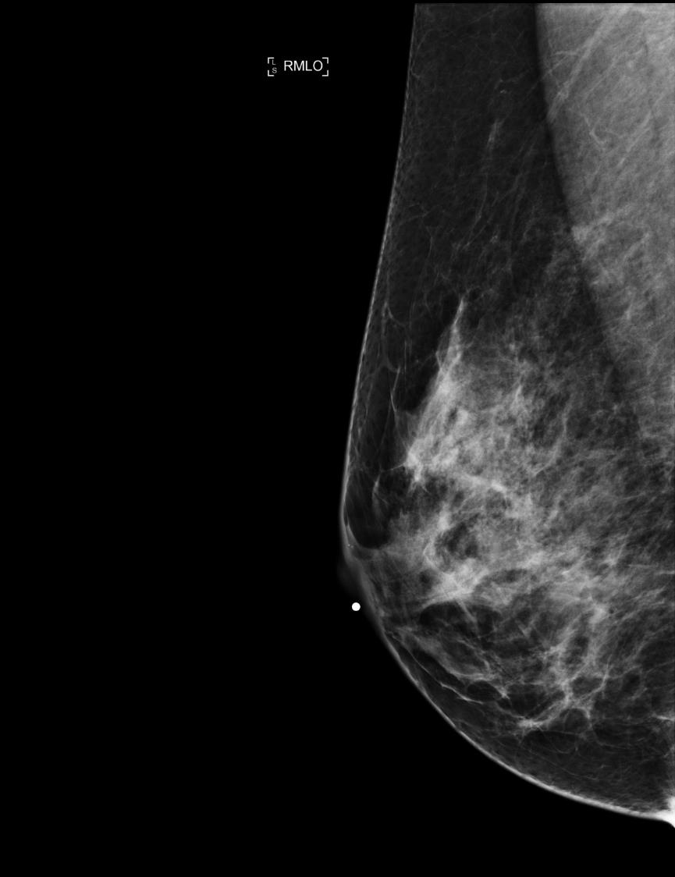
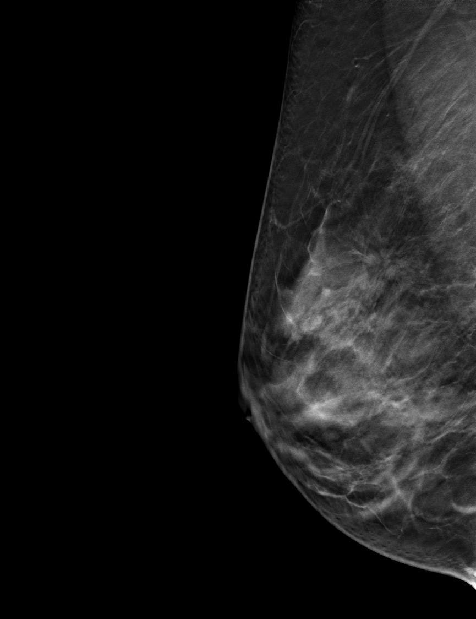
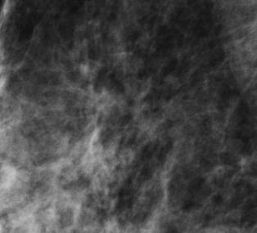
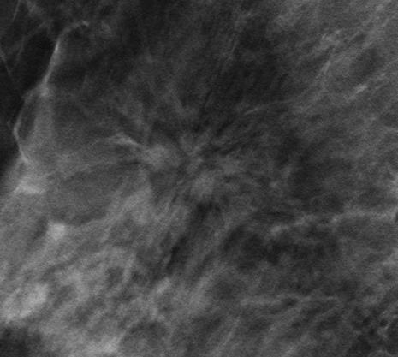
Cancer Case 2
2D
Tomosynthesis
Slice 16
Notes:
Cancer Case 2
Right image is the 2D right MLO view and the left image is the reconstructed slice of the tomosynthesis data.
Left Click twice to display enlargements of areas of interest
Routine Screening with Combination tomosynthesis/2D = 2D Mammogram essentially negative
Tomosynthesis RMLO reveals an area of architectural distortion in the superior aspect
Demo Points:
Tomo only cancer
Diagnostic views do not demonstrate lesion and provide no added information
Tomosynthesis stream lines work-up:
Definitive demonstration of lesion, directs work-up for sonography without need for extra views
Tomosynthesis can localize a lesion to better direct sonography

Slide 37
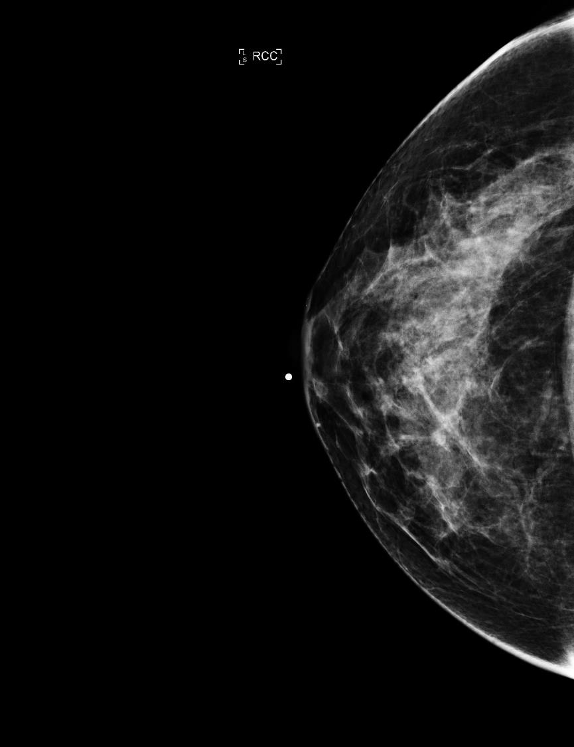
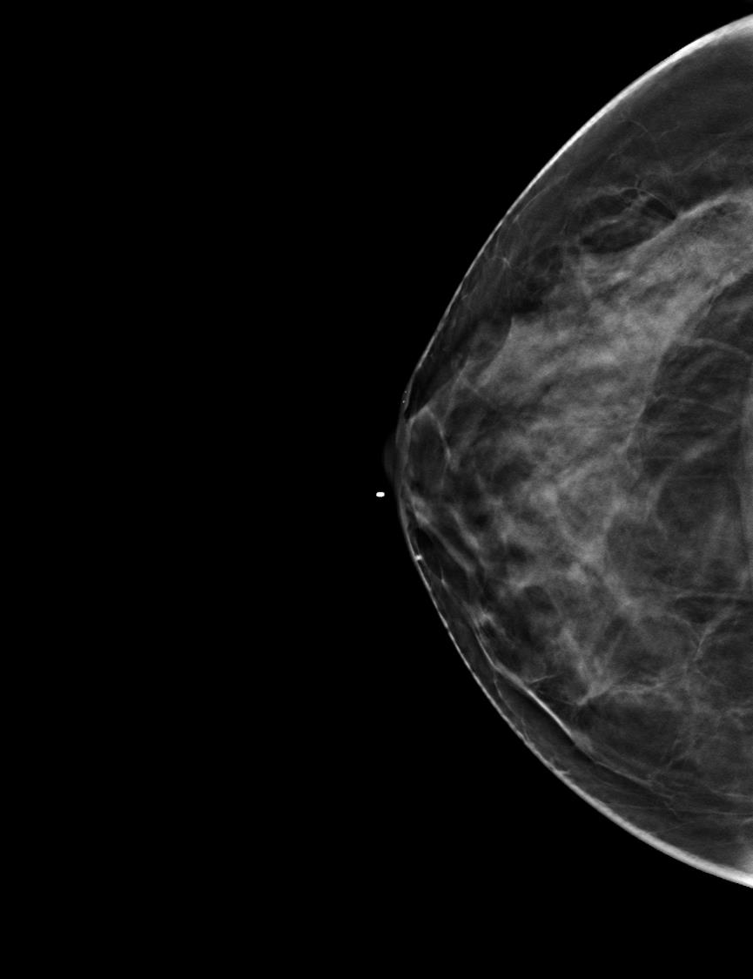
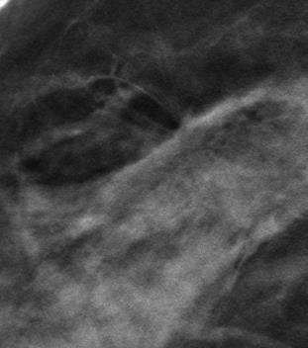
Cancer Case 2
2D
Tomosynthesis
Slice 28
Notes:
Cancer Case 2
2D Right CC compared to reconstructed slice from tomo data set
LEFT CLICK to display enlargement of area of interest

Slide 38

Cancer Case 2
RCC
RMLO
Breast Tomosynthesis
Slice 28
Breast Tomosynthesis
Slice 16
Notes:
Cancer Case 2
Retrospectively visible on tomosynthesis CC, but very subtle

Slide 39
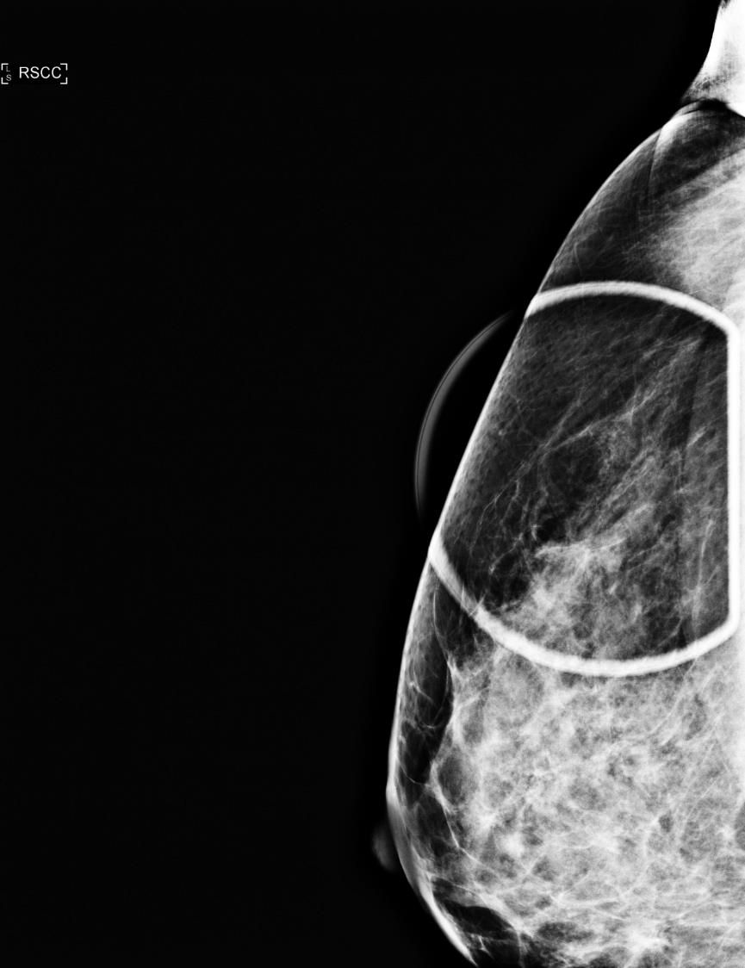
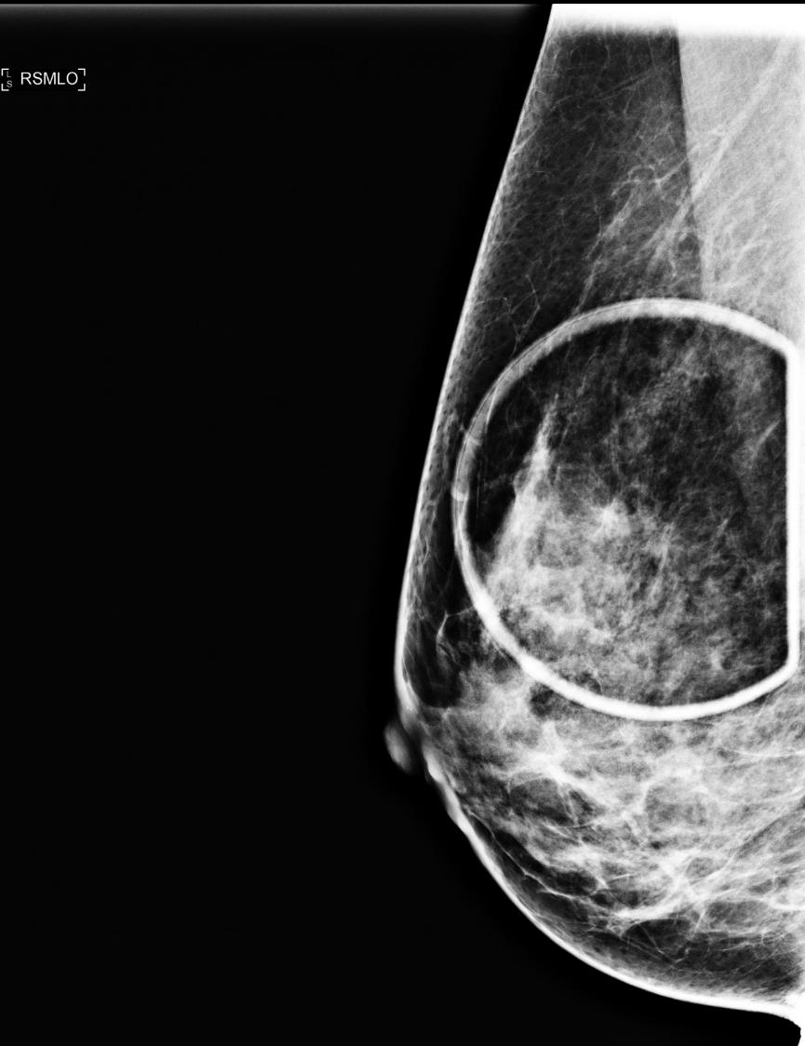
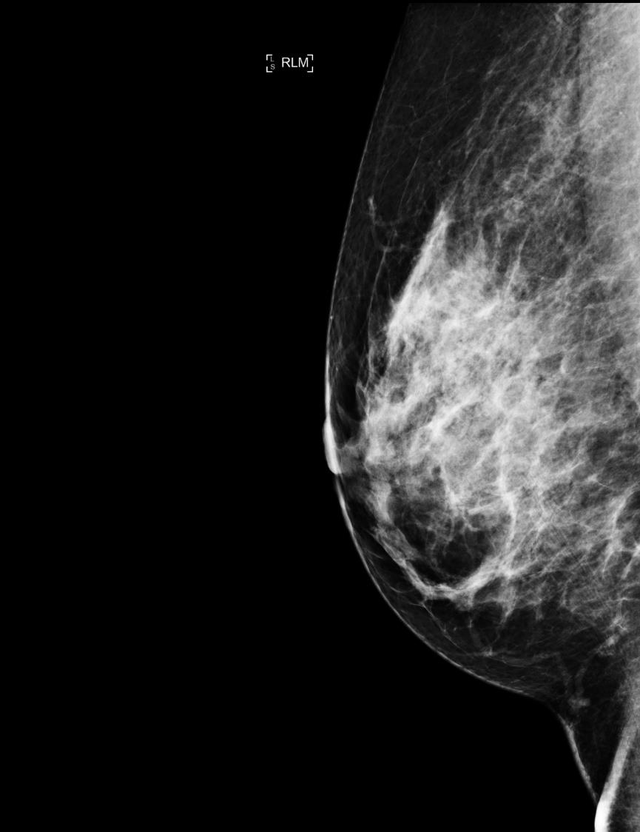
Cancer Case 2
Diagnostic Work-up Views
Diagnostic Work-up Images 12/09/11
Notes:
Cancer Case 2
2D spot view with 90° lateral projection
Diagnostic views add no information and do not reveal the lesion
Tomo only cancer
Diagnostic views do not demonstrate lesion
Diagnostic views provide no added information
Tomosynthesis stream lines work-up:
Definitive demonstration of lesion, directs work-up for sonography without need for extra views
Tomosynthesis can localize a lesion to better direct sonography

Slide 40
Clinical Study: Cancer Case 3
Routine screening mammogram
2D mammogram shows calcifications in the Left upper inner quadrant (UIQ) in both projections - one view only finding
Tomo slices show calcifications well along with a subtle spiculated mass in the Left CC
No definitive correlate on MLO
Pathology: Invasive Ductal Carcinoma

Slide 41
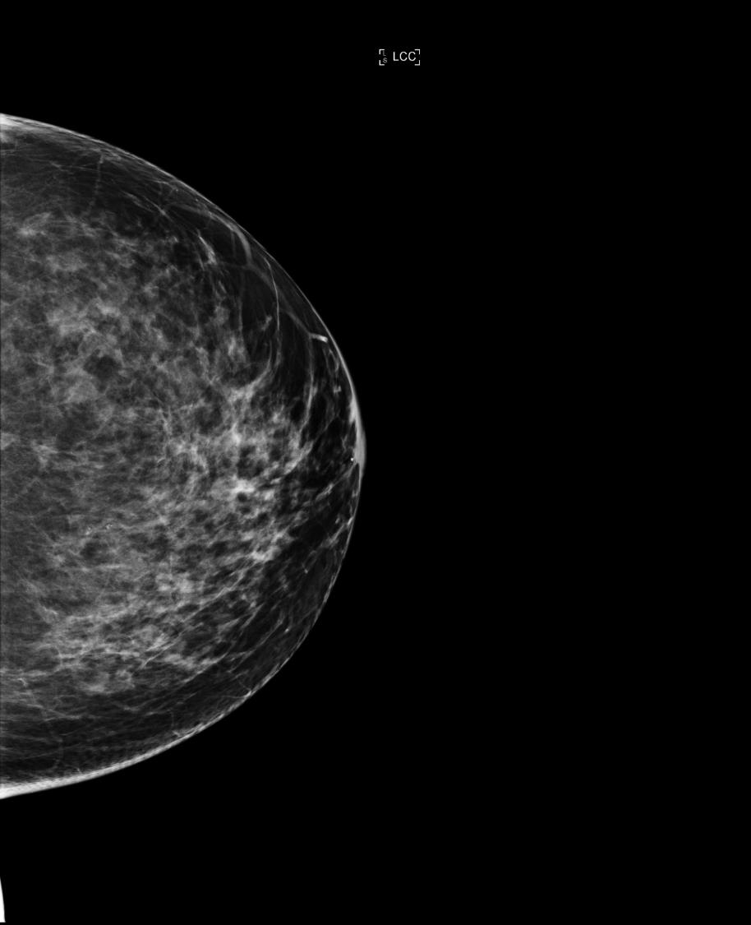
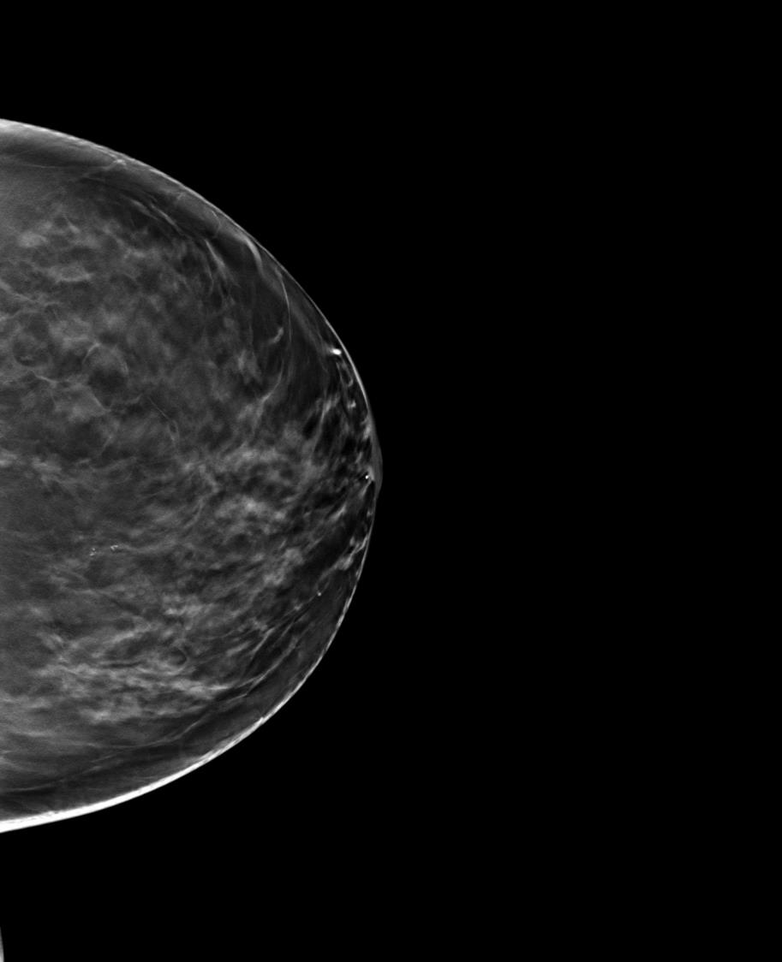
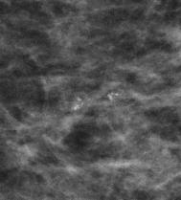
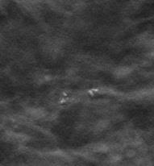
Cancer Case 3
Screening Combo 06/20/2012
2D
Breast Tomosynthesis
Slice 37
Notes:
Cancer Case 3
Calcifications seen in both the 2D and tomosynthesis images
LEFT CLICK twice to view enlarged areas

Slide 42
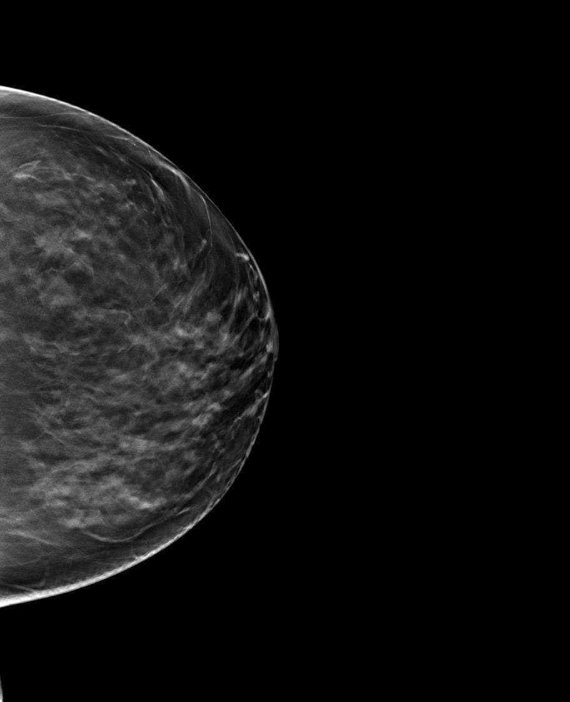
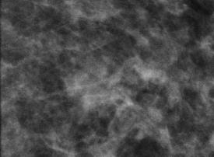
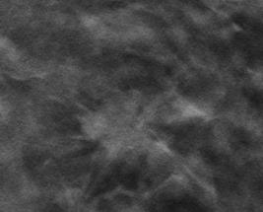
Screening Combo 06/20/2012
Cancer Case 3
2D
Breast Tomosynthesis
Slice 27
Notes:
Cancer Case 3
Calcifications seen in both the 2D and tomosynthesis images but within the tomosynthesis reconstructed slices,
LEFT CLICK twice to view enlarged areas
This case illustrates how tomosynthesis reveals more detailed structures and lesions not easily seen in 2D

Slide 43
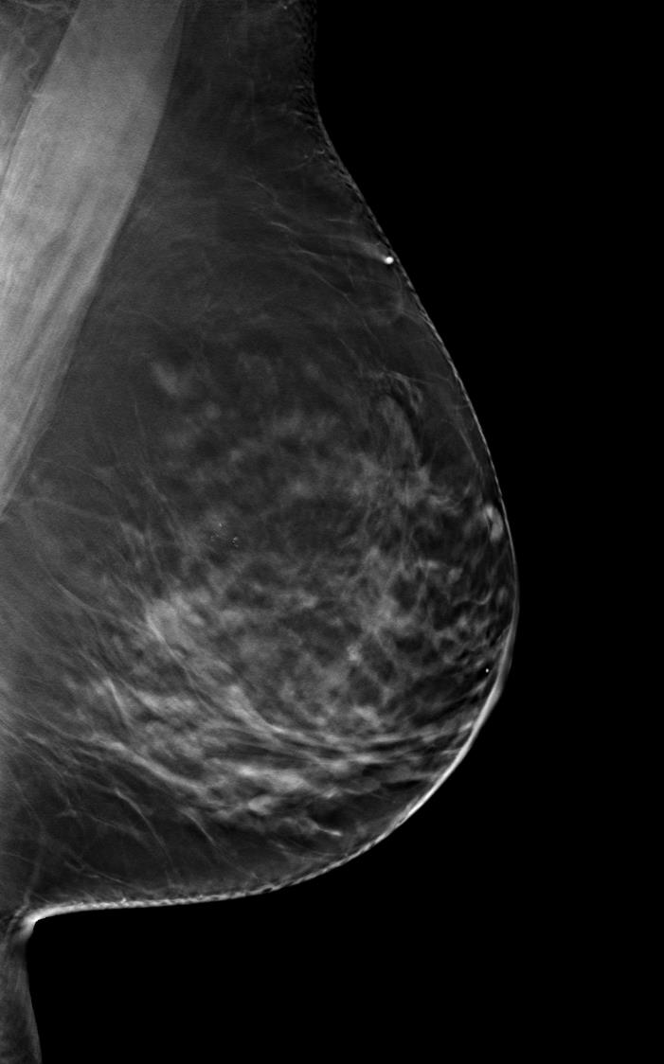
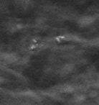

Cancer Case 3
Tomosynthesis Reconstructed Slices
LCC
LCC
Notes:
Cancer Case 3
Left CC & MLO reconstructed slices displaying the calcifications.

Slide 44
Cancer Case 3
LCC
LCC
2D
Tomosynthesis
Slice 27
Notes:
Cancer Case 3
This case illustrates how tomosynthesis provides improved detail of lesions.
Left click to display enlarged areas

Slide 45
Clinical Study: Superimposition of Tissues – Case 1
Combo mode exam completed
2D right CC displays density in the subareolar region of the breast
Tomosynthesis displays overlapping tissue

Slide 46
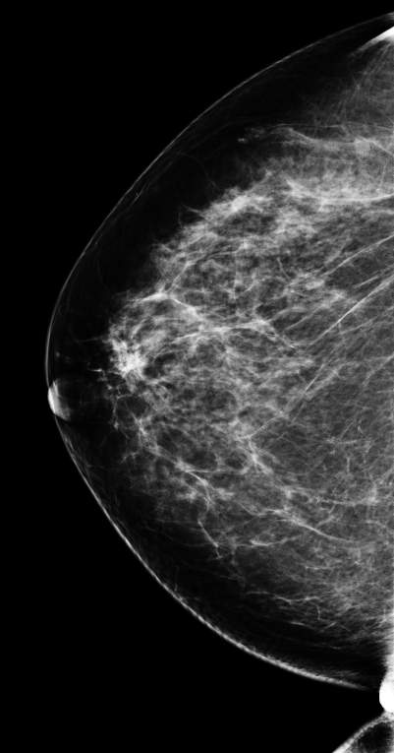
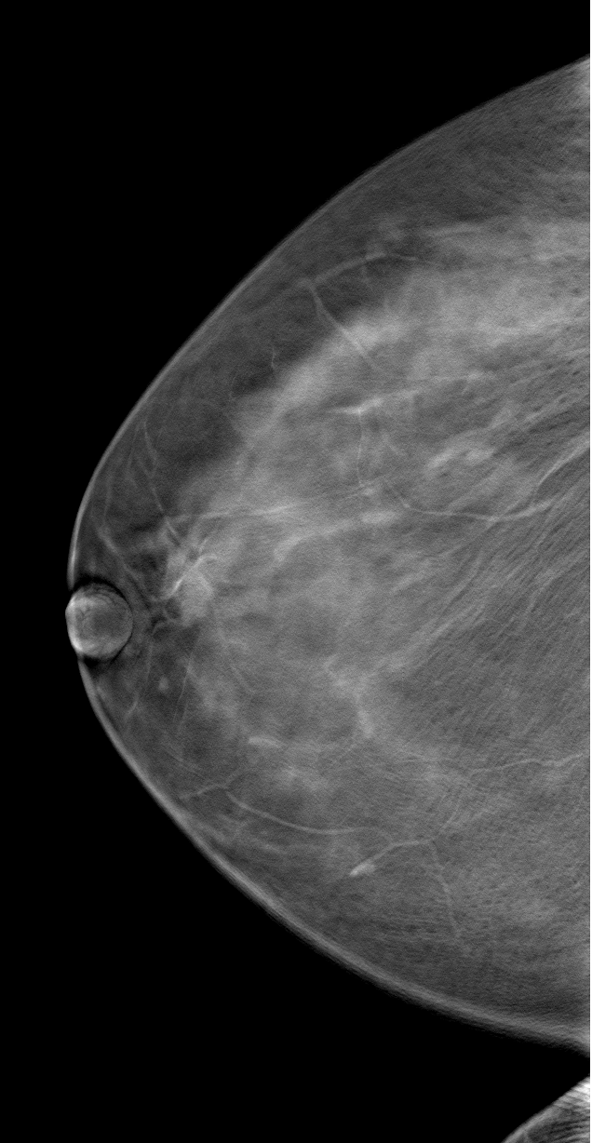
SIP Case 1
RCC
RCC
Tomosynthesis slice
2D
Notes:
Superimposition - Case 1
Click on tomo image on right in slide show mode to begin movie (01050205_RCC_FULL_TOMO.avi)
And here, in another screening mammogram, we wonder if there’s a possible lesion in the subareolar region of the breast. This is the limits for mammo-
So, now we’re paging through the tomosynthesis study in one-millimeter increments from inferior to superior, looking at the structures in the subareolar region of the breast, and we’re actually able to see that, in fact, there is no lesion present.

Slide 47
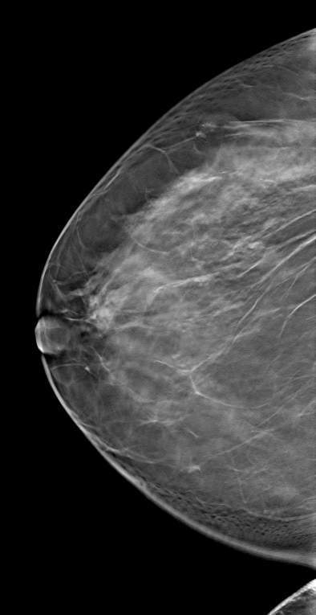
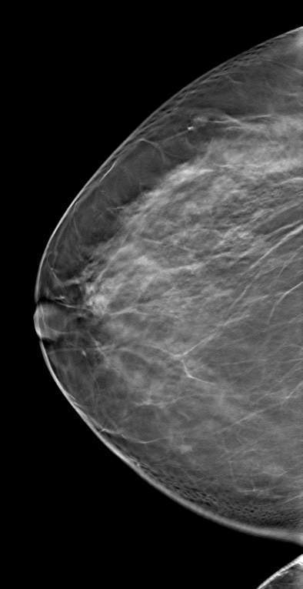
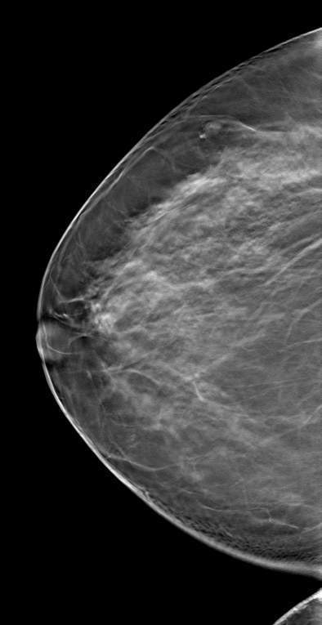
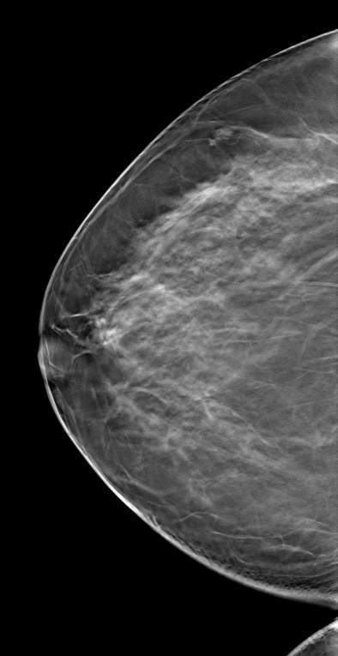
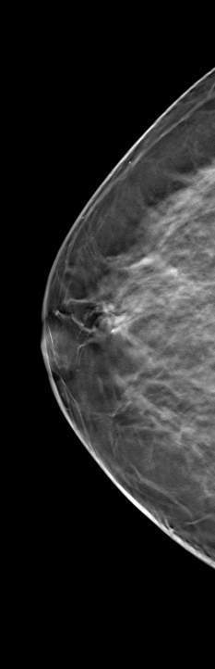
SIP Case 1
Slice 14 18 22 26 30
Notes:
Superimposition - SIP Case 1
14,18,22,26,30 – This shows that this was just overlapping tissue.
You can actually pick out individual structures on the separate slices, which summate to form the potential lesion that we see on the two-dimensional projection image.

Slide 48
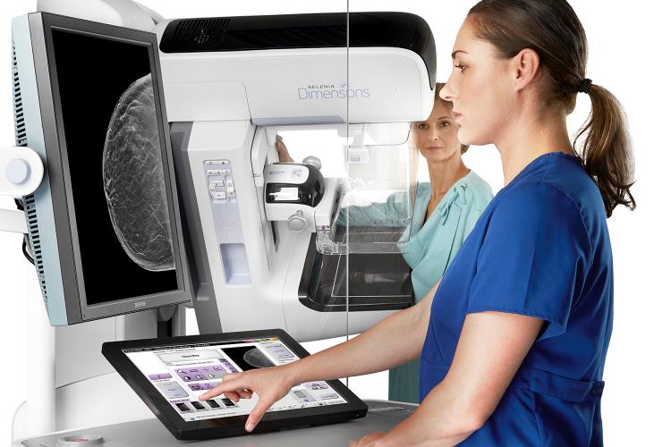

The Future of Breast Imaging
Hologic, Dimensions, Selenia, and other associated logos are trademarks and/or registered trademarks of Hologic, Inc. and/or its subsidiaries in the United States and /or other countries.

Slide 49
Additional publication information
FDA PMA submission P080003/S001.
Friedewald SM, Rafferty EA, Rose SL, Durand MA, Plecha DM, Greenberg JS, Hayes MK, Copit DS, Carlson KL, Cink TM, Barke LD, Greer LN, Miller DP, Conant EF. Breast cancer screening using tomosynthesis in combination with digital mammography. JAMA. 2014 Jun 25;311(24):2499-507. doi: 10.1001/jama.2014.6095.
Skaane P, Bandos AI, Gullien R, Eben EB, Ekseth U, Haakenaasen U, Izadi M, Jebsen IN, Jahr G, Krager M, Niklason LT, Hofvind S, Gur D. Comparison of digital mammography alone and digital mammography plus tomosynthesis in a population-based screening program. Radiology. 2013 Apr;267(1):47-56. doi:10.1148/radiol.12121373. Epub 2013 Jan 7.
Ciatto S, Houssami N, Bernardi D, Caumo F, Pellegrini M, Brunelli S, Tuttobene P, Bricolo P, Fantò C, Valentini M, Montemezzi S, Macaskill P. Integration of 3D digital mammography with tomosynthesis for population breast-cancer screening (STORM): a prospective comparison study. Lancet Oncol. 2013 Jun;14(7):583-9. doi:10.1016/S1470-2045(13)70134-7. Epub 2013 Apr 25.
Rose SL, Tidwell AL, Bujnoch LJ, Kushwaha AC, Nordmann AS, Sexton R Jr. Implementation of breast tomosynthesis in a routine screening practice: an observational study. AJR Am J Roentgenol. 2013 Jun;200(6):1401-8. doi:10.2214/AJR.12.9672.
Conant E, Mitra N, McCarthy A, et al. “Implementing Digital Breast Tomosynthesis (DBT) in a Screening Population: PPV1 as a Measure of Outcome” (paper presented at the annual meeting of the Radiological Society of North America, Chicago, Il, December 2013).
Greenberg J, Javitt M, Katzen J, et al. “Clinical Performance Metrics of 3D Digital Breast Tomosynthesis Compared With 2D Digital Mammography for Breast Cancer Screening in Community Practice.” AJR Am J Roentgenol. 2014 Sept; 203:687-693. Epub 2014 Jun 11.
Haas B, Kalra V, Geisel J et al. “Comparison of Tomosynthesis Plus Digital Mammography and Digital Mammography Alone for Breast Cancer Screening” Radiology. 2013 Dec;269(3):694-700. Epub 2013 Jul 30.
Zuley ML, Bandos AI, Ganott MA, Sumkin JH, Kelly AE, Catullo VJ, Rathfon GY, Lu AH, Gur D. Digital breast tomosynthesis versus supplemental diagnostic mammographic views for evaluation of noncalcified breast lesions. Radiology. 2013 Jan;266(1):89-95. doi: 10.1148/radiol.12120552. Epub 2012 Nov 9.
Dang P, Humphrey K, Freer P, Halpern E, Saksena M, Rafferty E. “Comparison of Lesion Detection and Characterization in Invasive Cancers Using Breast Tomosynthesis versus Conventional Mammography” (paper presented at the annual meeting of the Radiological Society of North America, Chicago, Il, December 2013).
Rafferty EA, Park JM, Philpotts LE, Poplack SP, Sumkin JH, Halpern EF, Niklason LT. Assessing radiologist performance using combined digital mammography and breast tomosynthesis compared with digital mammography alone: results of a multicenter, multireader trial. Radiology. 2013 Jan;266(1):104-13. doi: 10.1148/radiol.12120674. Epub 2012 Nov 20
Skaane P, Bandos AI, Eben EB, Jebsen IN, Krager M, Haakenaasen U, Ekseth U, Izadi M, Hofvind S, Gullien R. Two-View Digital Breast Tomosynthesis Screening with Synthetically Reconstructed Projection Images: Comparison with Digital Breast Tomosynthesis with Full-Field Digital Mammographic Images. Radiology. 2014 Jan 24:131391.
Zuley ML, Guo B, Catullo VJ, Chough DM, Kelly AE, Lu AH, Rathfon GY, Lee Spangler M, Sumkin JH, Wallace LP, Bandos AI. Comparison of Two-dimensional Synthesized Mammograms versus Original Digital Mammograms Alone and in Combination with Tomosynthesis Images. Radiology. 2014 Jan 21:131530.
Kalra V, Haas B, Forman H et al. “Cost-Effectiveness of Digital Breast Tomosynthesis.” (paper presented at the annual meeting of the Radiological Society of North America, Chicago, Il, November 2012).
Rafferty EA, Park JM, Philpotts LE, Poplack SP, Sumkin JH, Halpern EF, Niklason LT. Diagnostic accuracy and recall rates for digital mammography and digital mammography combined with one-view and two-view tomosynthesis: results of an enriched reader study. AJR Am J Roentgenol. 2014 Feb;202(2):273-81. doi: 10.2214/AJR.13.11240.
Beck, N, Butler, R.; Durand, M.; Andrejeva, L.; Hooley, R.; Horvath, L.; Raghu, M.; Philpotts, L. “One-View Versus Two-View Tomosynthesis: A Comparison of Breast Cancer Visibility in the Mediolateral Oblique and Craniocaudal Views.” Paper presented at the annual meeting for the American Roentgen Ray Society, Washington, D.C. April 2013.
Brodersen J, Siersma V. “Long-Term Psychosocial Consequences of False-Positive Screening Mammography.” The Annals of Family Medicine 2013 Mar;11(2):106-15.

