Slide 1
Staying on the Cutting Edge of Screening
Genius™ 3D MAMMOGRAPHY™ for the OB-GYN Physician*
*Genius 3D MAMMOGRAPHY™ exams are available on Hologic Selenia™ Dimensions™ systems

Slide 2
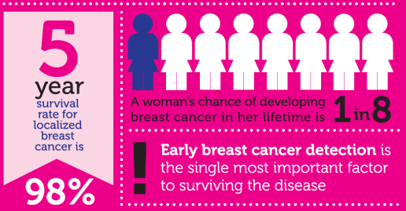
Historical Impact and Prevalence
ACOG and other leading health and medical organizations recommend regular screening mammography to reduce breast cancer mortality
American Cancer Society
National Comprehensive Cancer Network
US Preventive Services Task Force
2

Slide 3
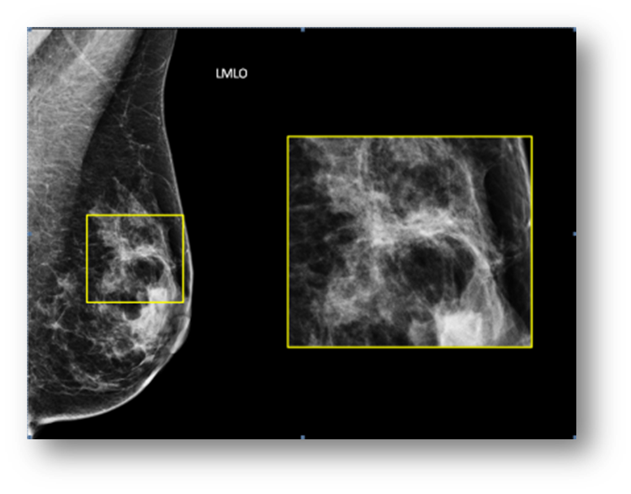
2D Mammography Challenges
Imaging Challenge
Overlapping tissue hides or mimics breast disease leading to false positive results
Impact
As many as 20% of breast cancers will be missed by mammography¹
In the U.S. ~10% of women are recalled for additional diagnostic work-up
A significant portion prove to have no abnormality, resulting in unnecessary anxiety and cost¹
Notes:
Why create something new when there 2D mammography is the perceived gold standard?
Well 2D mammography has limitations:
Screening mammography reduce the mortality rate: 15 to 50%
20% of breast cancers will be missed though
Recall rates are ~ 10%

Slide 4

2D Mammography Challenges – Impact on Your Practice
Patient consultation calls
Follow-up and tracking
For your patients:
Emotional impact
Financial costs (time off from work, co-pays)
For you:
Notes:
About 500, 000 women would be the normal callback if women had 2D (10% of all screened women) – with tomo added the reduction in call backs is between 20 – 40%, which is 100, 000 – 200, 000 fewer callbacks. That is a significant amount of time saved from having fewer calls to make, less follow up and tracking, and reduced impact on patient anxiety.

Slide 5

Genius™ 3D MAMMOGRAPHY™ Exams
Available in the U.S. since 2011
Outside the U.S. since 2009
Over 5 million women in the U.S. have been screened with Genius 3D™ exams*
*Data on file Hologic

Slide 6
Clinical Benefits of Genius™ 3D MAMMOGRAPHY™ exams
Breast cancer screening with Genius™ 3D™ exams finds invasive cancers missed with conventional 2D mammography²⁻⁵
Earlier Detection
Gives radiologists the confidence to reduce recall rates⁴⁻⁸
Reduced Recalls
Masses, distortions and asymmetric densities are better visualized⁹⁻¹¹
Better Visualization
3
Notes:
Skaane P, Gullien R, Eben EB, et. al. Reading time of FFDM and tomosynthesis in a population-based screening program. Radiological Society of North America annual meeting. Chicago, Il, 2011.
Per Skaane – relative increase in cancer detection using DBT was 47%
http://rsna2011.rsna.org/search/search.cfm?action=add&filter=Author&value=121207
During the first 3 months of the trial, 4,534 women underwent FFDM, of which 3,356 (74%) were examined with DBT. Excluding the reading times for the first month (learning curve), readers with few interpretations, and outliers, the mean interpretation time (all readers) for FFDM (excluding arm with CAD) was 49 sec. (range, 32-81) and the mean reading time for DBT (excluding synthetic 2D arm) 92 sec. (range, 37-157). Of the 33 cancers detected so far, 25 cancers had independent double reading for both FFDM and DBT. 8 cancers were missed in the FFDM arm and none in the DBT arm. Thus, the relative increase in cancer detection using DBT was 47% (17+8/17). There were 9 individual false negative interpretations in the DBT arm, of which 6 had shorter interpretation time than the mean of 92 sec.
http://www.docguide.com/journals/breast-cancer-res-treat?tsid=6
Prospective study of breast tomosynthesis as a triage to assessment in screening; Bernardi D, Ciatto S, Pellegrini M, Tuttobene P, Fanto' C, Valentini M, Michele SD, Peterlongo P, Houssami N; Breast Cancer Research and Treatment (Jan 2012)
There is limited evidence on the role of 3D mammography with tomosynthesis in breast screening, although early studies suggest that it may improve specificity. We prospectively evaluated the effect of integrating 3D mammography as a triage to assessment in 158 consecutive recalls to assessment (recalled in standard 2D-mammographic screening) in asymptomatic subjects. Radiologists provided 3D mammography-based opinion as to whether recall/assessment was warranted or unnecessary, and all subjects proceeded to assessment. 3D triage was positive (confirmed the need for assessment) in all 21 subjects with breast cancer (there were no false negatives), and would have avoided recall in 102 of 137 (74.4%) subjects with a negative/benign final outcome in whom 3D triage did not recommend recall. Proportion of true negative 3D triage (as a proxy for potential reduction in recalls) was slightly higher in dense than non-dense breasts, did not differ across age-groups, but was significantly associated with the type of lesion seen on imaging (being highest for distortions, asymmetric densities, and lesions with ill-defined margins). While the simulation design may have over-estimated the potential for 3D mammography triage to reduce recalls, this study clearly demonstrates its capability to improve breast screening specificity and to reduce recall rates. Future studies of 3D mammography should further assess its role as a recall-reducing strategy in screening practice and should include formal cost-analysis.

Slide 7


Breast Tomosynthesis: Principle of Operation
X-ray tube moves in an arc across the breast
A series of low dose images are acquired from different angles to create a tomosynthesis image set
A 2D image is acquired by an additional exposure, or generated from the tomosynthesis image set without an additional exposure
Total dose is within allowable limits
{
Compression Paddle
Reconstructed Slices
Compressed Breast
Detector Housing
Notes:
The x-ray tube moves in a 15 degree arc
15 low dose images are acquired – these are the projection images
Dose is equal to a single 2D mammogram
Reconstructed slices are 1 mm in thickness

Slide 8
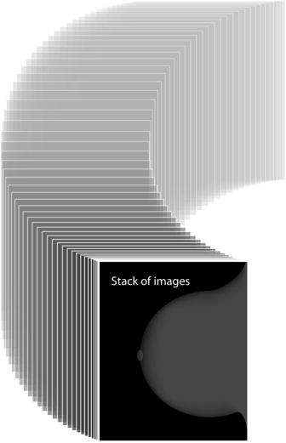
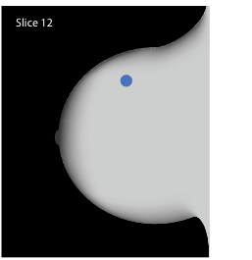
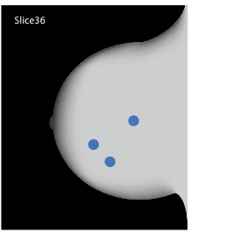
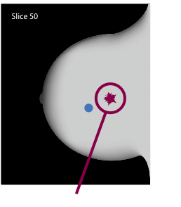
Breast Tomosynthesis Improves Visibility by Reducing Tissue Superimposition

Slide 9
Genius 3D™ exams Clinical Efficacy*
Genius™ 3D exams are superior to 2D mammography alone^{5,12}
Genius™ 3D significantly increases cancer detection
More than 40% increase in invasive cancer detection²⁻⁵
At least a 15% reduction in recalls⁴⁻⁸
Combined with 2D, tomosynthesis is a more accurate mammogram^{3,5,13}
Fewer false positives with 3D may result in fewer unneeded biopsies^{5,10}
*Studies utilized Hologic Selenia Dimensions systems
Notes:
Here is our current data concerning tomosynthesis clinical efficacy:
(click) When combined, Hologic's breast tomosynthesis and 2D digital mammography allow you to find cancers earlier, significantly improving your cancer detection rate compared to conventional 2D mammography alone.
(click) a 40% increase for detecting invasive cancers as well as a 27% increase in all types of breast cancer
(click) Compared to 2D alone, reports indicate a 20 to 40% reduction in recall rates. This is based on a site’s practices or protocols.
(click) All women benefit with the addition of Hologic’s tomosynthesis to their screening exams.

Slide 10
A landmark study in JAMA – June 2014
454,850 examinations from 13 centers interpreted by 139 radiologists over two time periods were retrospectively analyzed²
15%
29%
41%
Notes:
In 2014, the Journal of the American Medical Association, published the results of a multi-center study.
Over 454,000 exams were performed with 139 radiologists reviewing these cases.
As you can see by the charts, 3D mammography demonstrated an increase in cancer detection rates with (CLICK x 2) a decrease in patient recalls. Click Here is our current data concerning tomosynthesis clinical efficacy:
(click) When combined, Hologic's 3D MAMMOGRAPHY EXAM and 2D digital mammography allow you to find cancers earlier, significantly improving your cancer detection rate compared to conventional 2D mammography alone.
(click) a 40% increase for detecting invasive cancers as well as a 27% increase in all types of breast cancer
(click) Compared to 2D alone, reports indicate a 20 to 40% reduction in recall rates. This is based on a site’s practices or protocols.
(click) All women benefit with the addition of Hologic’s tomosynthesis to their screening exams.

Slide 11
A landmark study in JAMA – June 2014
 | 2D | 2D + 3D™ Mammography | Relative Change | P-Value
PPV for Recall | 4.3% | 6.4% | +49% | P<.001
PPV for Biopsy | 24.2% | 29.2% | +21% | P<.001
Notes:
This next chart reveals the results for the PPV for recall and biopsy.

Slide 12
Patients across all age groups and breast densities benefit from the addition of 3D™ screening^{3,14}
Notes:
The breasts are almost entirely fatty
There are scattered areas of fibroglandular density
The breasts are heterogeneously dense, which may obscure small masses
The breasts are extremely dense, which lowers the sensitivity of mammography
The authors concluded that the addition of tomosynthesis to digital mammography in the screening population resulted in a significant increase in cancer detection rate, particularly for invasive cancers, and a simultaneous significant decrease in false-positive rate. The increase was observed across all breast densities.

Slide 13
Standard Radiation Dose
MQSA limit = 3 mGy
Notes:
Although the benefits of 3D mammography far outweigh the perceived risks, some critics have expressed concern over 3D mammography’s radiation dose as it is double that of a conventional 2D mammogram.
Additional effective dose of 3D is equivalent to about 2 months of annual natural background radiation in the United States.
3 mGy per exposure is the limit that the FDA’s Mammography Quality Standards Act allows. This is based on an acrylic phantom that is 4.5 cm in thickness.
This chart represents the dose:
Click – the convention 2D exposure is ~ 1.2 mGy
Click – a tomo scan can be close to 1.5 mGy
Click – now you can see the combo mode: 2D + 3D scan is ~2.8 mGY
But with the use of a C-View software, to generate a 2D image, click when performing a tomo scan, the dose is dropped back down to below 1.5 mGy because only the tomo scan is acquired and the C-View software generates a 2D image.

Slide 14
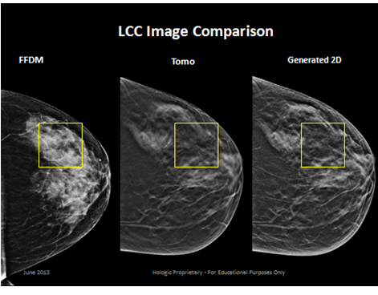
2D Generated Images
Software that generates a 2D image from the 3D™ data set
Genius™ 3D MAMMOGRAPHY exam with 2D generated images is superior than 2D^{13,15}
Notes:
Hologic also offers a lower dose software option, which generates a 2D image from the 3D data set

Slide 15
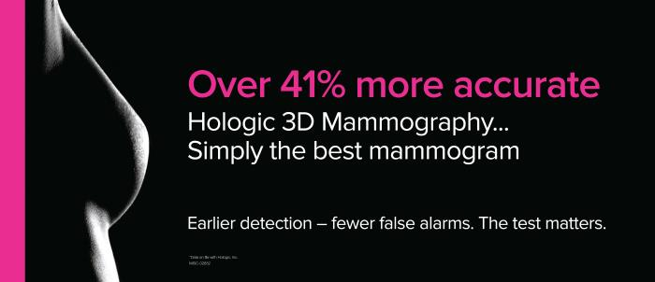
Genius™ 3D MAMMOGRAPHY exam: Simply a Better Mammogram
More accurate, finding more invasive cancers earlier
Fewer false positives
Less patient anxiety

Slide 16
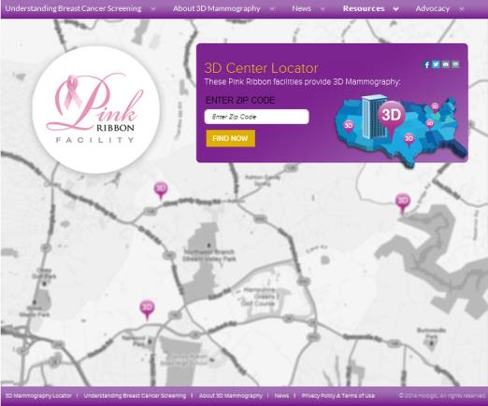
How do I find a Genius™ 3D™ exam provider near me?
Go to www.hologic3d.com
Enter your zip code to find a facility. It’s that easy!
Notes:
Not all facilities who offer 3D has given Hologic permission to advertise them through this zip code search, but it’s the most comprehensive way we have at this time.

Slide 17
What’s the risk of not having a Genius™ 3D™ exam?
Thank you

Slide 18
Additional publication information
http://www.cancer.gov/cancertopics/factsheet/detection/mammograms
Ciatto S, Houssami N, Bernardi D, Caumo F, Pellegrini M, Brunelli S, Tuttobene P, Bricolo P, Fantò C, Valentini M, Montemezzi S, Macaskill P. Integration of 3D digital mammography with tomosynthesis for population breast-cancer screening (STORM): a prospective comparison study. Lancet Oncol. 2013 Jun;14(7):583-9. doi:10.1016/S1470-2045(13)70134-7. Epub 2013 Apr 25.
Skaane P, Bandos AI, Gullien R, Eben EB, Ekseth U, Haakenaasen U, Izadi M, Jebsen IN, Jahr G, Krager M, Niklason LT, Hofvind S, Gur D. Comparison of digital mammography alone and digital mammography plus tomosynthesis in a population-based screening program. Radiology. 2013 Apr;267(1):47-56. doi:10.1148/radiol.12121373. Epub 2013 Jan 7.
Rose SL, Tidwell AL, Bujnoch LJ, Kushwaha AC, Nordmann AS, Sexton R Jr. Implementation of breast tomosynthesis in a routine screening practice: an observational study. AJR Am J Roentgenol. 2013 Jun;200(6):1401-8. doi:10.2214/AJR.12.9672.
Friedewald SM, Rafferty EA, Rose SL, Durand MA, Plecha DM, Greenberg JS, Hayes MK, Copit DS, Carlson KL, Cink TM, Barke LD, Greer LN, Miller DP, Conant EF. Breast cancer screening using tomosynthesis in combination with digital mammography. JAMA. 2014 Jun 25;311(24):2499-507. doi: 10.1001/jama.2014.6095.
Philpotts L, Raghu M, Durand M, Hooley R, Vashi R, Horvath L, Geisel J, Butler R. Initial Experience With Digital Breast Tomosynthesis in Screening Mammography. Presented at the ARRS 2012, Scientific Session 22 - Breast Imaging: Screening/Emerging Technologies.
Haas B, Kalra V, Raghu M, Philpotts L. Performance of digital breast tomosynthesis compared to conventional mammography for breast screening. Radiological society of North America annual meeting. Chicago, Il, 2012.
Destounis S, Murphy P, Seifert P, Somerville P, Paulis L, Cavanaugh D, Arieno A, Morgan R. “Experience with Combination 2D/3D Breast Tomosynthesis vs FFDM in the Screening Environment.” (paper presented at the Radiological Society of North America. Chicago, Il, November 2012.)
Bernardi D, Ciatto S, Pellegrini M, Tuttobene P, Fanto' C, Valentini M, Michele SD, Peterlongo P, Houssami N. Prospective study of breast tomosynthesis as a triage to assessment in screening. Breast Cancer Res Treat. 2012 May;133(1):267-71. doi: 10.1007/s10549-012-1959-y. Epub 2012 Jan 22.
Zuley ML, Bandos AI, Ganott MA, Sumkin JH, Kelly AE, Catullo VJ, Rathfon GY, Lu AH, Gur D. Digital breast tomosynthesis versus supplemental diagnostic mammographic views for evaluation of noncalcified breast lesions. Radiology. 2013 Jan;266(1):89-95. doi: 10.1148/radiol.12120552. Epub 2012 Nov 9.
Dang P, Humphrey K, Freer P, Halpern E, Saksena M, Rafferty E. “Comparison of Lesion Detection and Characterization in Invasive Cancers Using Breast Tomosynthesis versus Conventional Mammography” (paper presented at the annual meeting of the Radiological Society of North America, Chicago, Il, December 2013).
Rafferty EA, Park JM, Philpotts LE, Poplack SP, Sumkin JH, Halpern EF, Niklason LT. Assessing radiologist performance using combined digital mammography and breast tomosynthesis compared with digital mammography alone: results of a multicenter, multireader trial. Radiology. 2013 Jan;266(1):104-13. doi: 10.1148/radiol.12120674. Epub 2012 Nov 20
Skaane P, Bandos AI, Eben EB, Jebsen IN, Krager M, Haakenaasen U, Ekseth U, Izadi M, Hofvind S, Gullien R. Two-View Digital Breast Tomosynthesis Screening with Synthetically Reconstructed Projection Images: Comparison with Digital Breast Tomosynthesis with Full-Field Digital Mammographic Images. Radiology. 2014 Jan 24:131391.
Rafferty EA, Niklason L. “FFDM versus FFDM with tomosynthesis for women with radiologically dense breasts: an enriched retrospective reader study.” (paper presented at the annual meeting for the Radiological Society of North America. Chicago, Il, November 2011).
Zuley ML, Guo B, Catullo VJ, Chough DM, Kelly AE, Lu AH, Rathfon GY, Lee Spangler M, Sumkin JH, Wallace LP, Bandos AI. Comparison of Two-dimensional Synthesized Mammograms versus Original Digital Mammograms Alone and in Combination with Tomosynthesis Images. Radiology. 2014 Jan 21:131530.

