Slide 1
Brevera® Breast Biopsy System with CorLumina® Imaging Technology
Notes:
This next section will introduce you to Hologic’s Brevera breast biopsy system with CorLumina imaging technology.
Currently, when a patient has a breast biopsy with an upright or prone imaging guidance system, there comes a point when the specimen needs to be imaged to confirm the accuracy of the tissue acquisition.
This new system improves workflow for the radiologist, technologist and patient.
Let me explain with the next few slides.
Next slide

Slide 2
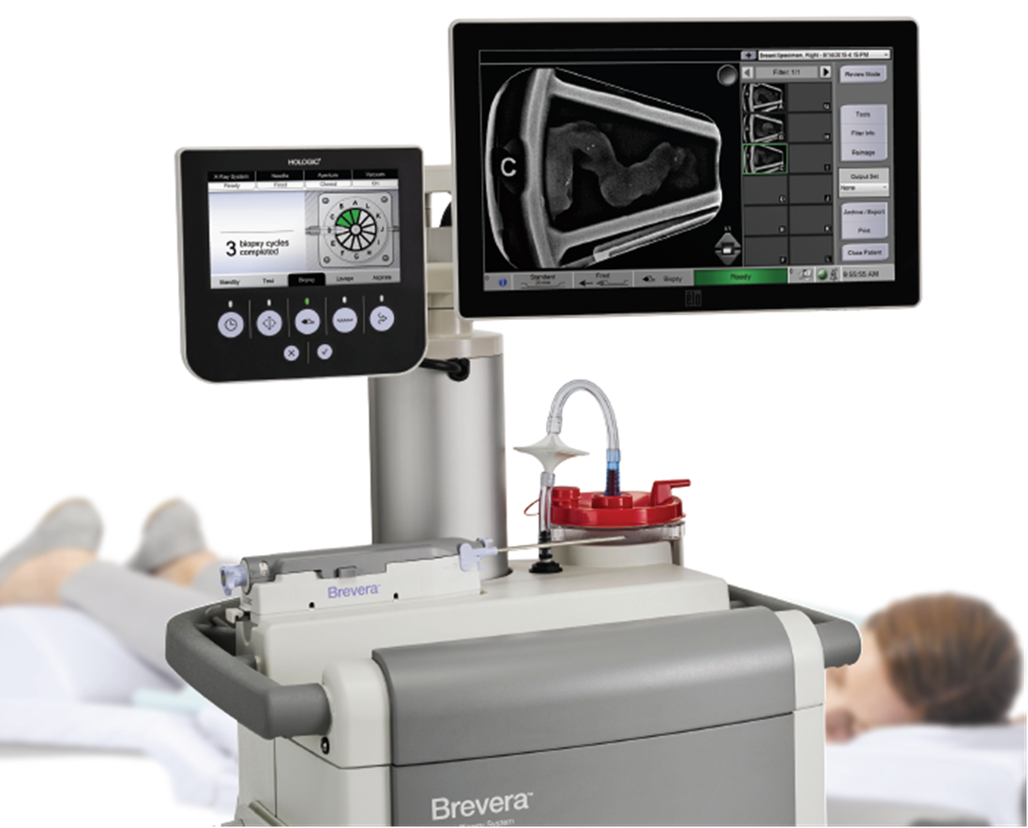
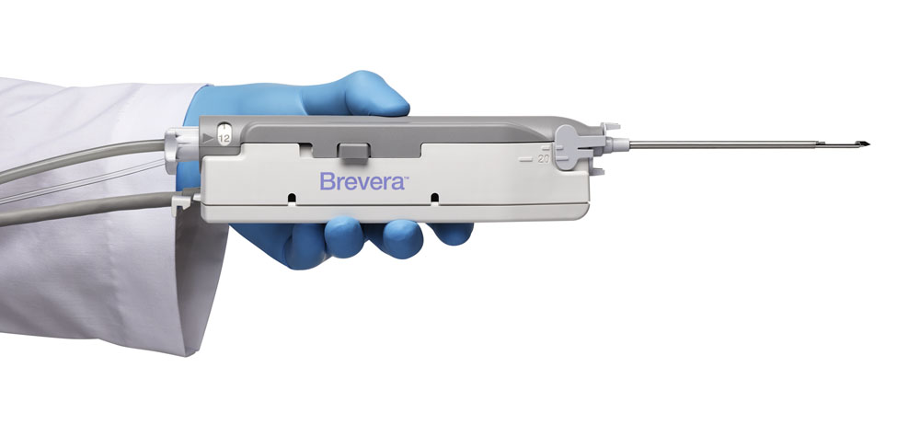
Integrated System
Notes:
The Brevera breast biopsy system is truly an integrated system.
This system combines breast tissue acquisition with real-time imaging that allows for immediate verification of the biopsy area.
The advanced post-biopsy handling of the specimen creates accuracy in identifying the tissue samples.
A brief 2 minute video will take us through the workflow of the Brevera system
Left Click – begins video – demonstrates Brevera’s functions

Slide 3

Notes:
This brief 2 minute video will take us through the workflow of the Brevera system.

Slide 4
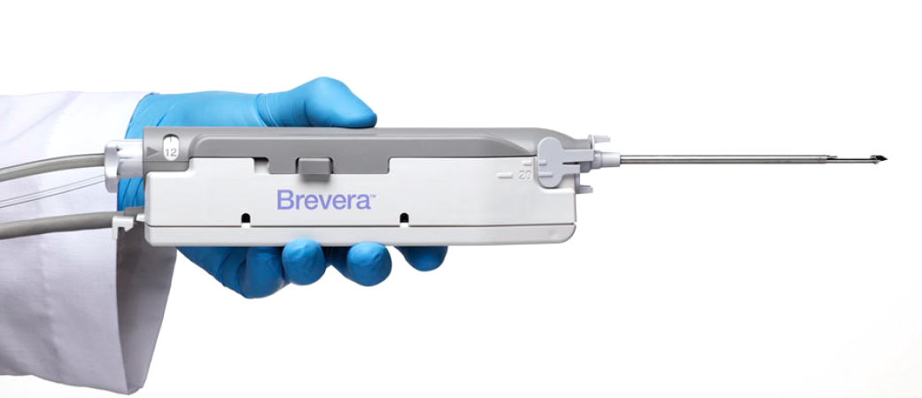



Benefits of an integrated solution
Enhance workflow*
Improve patient
experience*
Increase Accuracy*
An intuitive user interface, real-time imaging, and automated specimen collection and separation work together to potentially reduce procedure times by up to 25% or more
Fast, accurate and streamlined procedures mean less time under compression and can result in a more positive biopsy experience for you and your patients
Real-time imaging delivers a wealth of information to the point of care – so you can make informed clinical decisions with confidence
*2015 Kadence International survey of 200 healthcare professionals
Notes:
There are several benefits with this integrated solution.
First, the workflow is greatly improved: imagine having the ability to capture tissue cores and image immediately.
The technologist would not have to take the specimens to another room to image the cores and then report back with the image results
Within a few minutes, verification of the sampling would be available
The detailed, real-time information of the tissue samples is viewed from a monitor within seconds
This delivers an improved patient experience: shorter biopsy procedure time

Slide 5
Enhance workflow – Automated process
Transfer breast tissue samples directly to fully shielded, CorLumina® system for imaging
Accurately separate & identify samples with a 12 chamber tissue filter
Send to pathology with little or no manual handling – protects sample integrity
PACS integration for image sharing & transfer of patient records
Notes:
Transfer breast tissue samples directly to the fully shielded, CorLumina® imaging system
Accurately separate and identify samples with a 12-chamber tissue filter to improve core handling
Send tissue from the patient to pathology with little or no manual handling to protect the integrity
of samples
Take advantage PACS integration for advanced image sharing and transfer of patient records

Slide 6
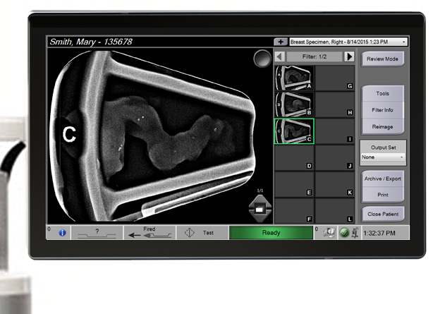
Increase accuracy
Tissue acquired and imaged
every ~8 seconds
Delivers information quickly for informed, confident clinical decisions
Notes:
With real-time imaging for instant verification, the Brevera® system delivers actionable information to the point of care. So you can make informed clinical decisions with confidence – on the spot.

Slide 7
Enhanced Workflow → Better Patient Experience
Start biopsy
Take samples
Remove samples
Prep samples for imaging
Transport samples
Manually image samples
Place tissue marker
Prep samples for pathology
Conventional Stereotactic Breast Biopsy
Brevera Integrated Breast Biopsy
Start biopsy
Take samples, image, verify and prep
Place tissue marker
up to 25% Faster*
*2015 Kadence International survey of 200 healthcare professionals
Notes:
A typical stereotactic breast biopsy has made time consuming steps.
Left click to display Brevera biopsy steps.
The Brevera system is designed to remove unnecessary steps to streamline and shorten procedure times by an average of 5-10 minutes.*
*2015 Kadence International survey of 200 healthcare professionals

Slide 8
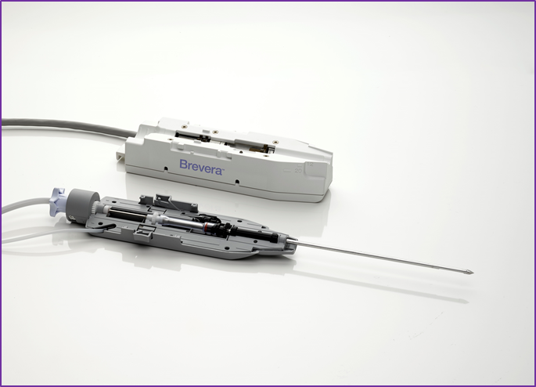
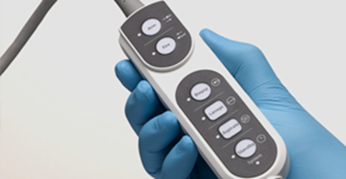
Brevera® biopsy device
Reusable device
Reusable device driver with disposable needle
Remote operation for tissue sampling & imaging
Disposable needle
Notes:
The Brevera® biopsy device puts the control in your hands
A reusable, device driver with disposable needles: adds functionality
Remote operation frees the technologist to focus on the patient while giving physicians full control of the procedure

Slide 9
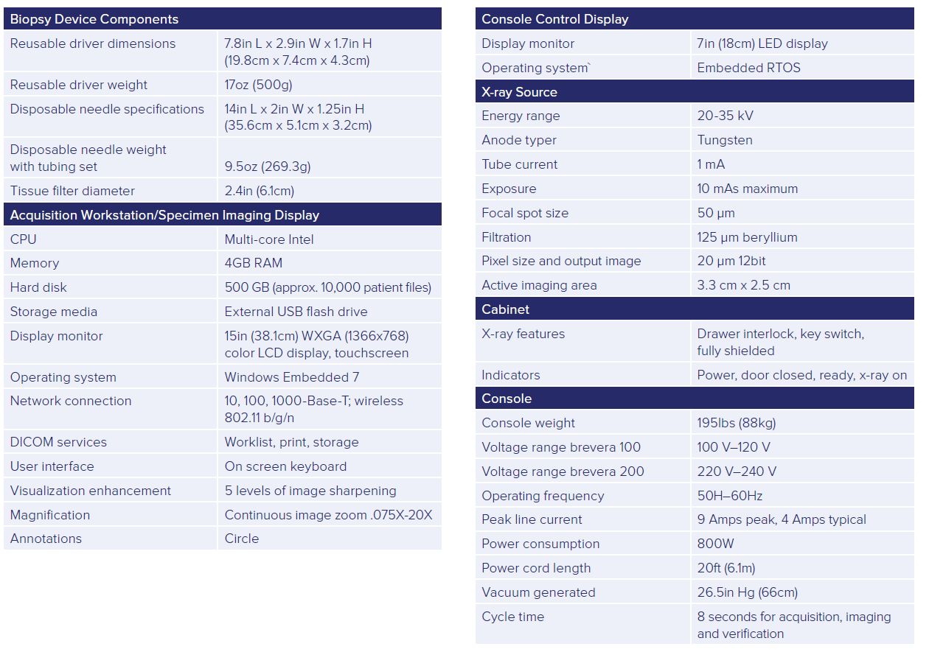
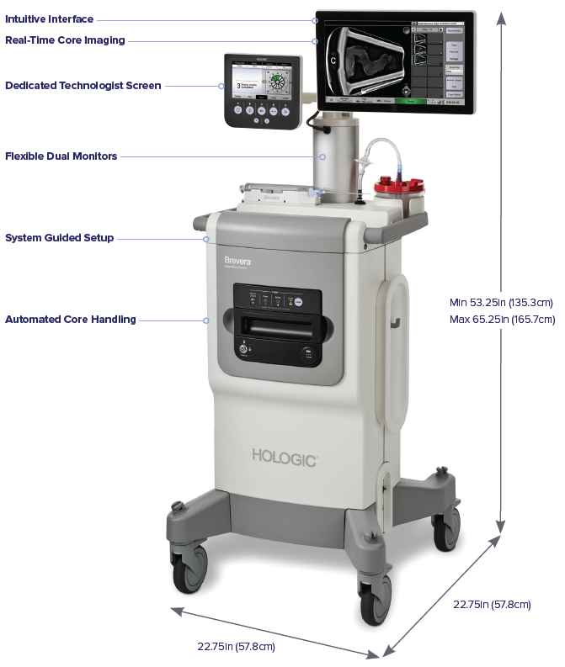
Technical Specifications
Notes:
The Hologic representative will have the technical datasheet available which lists all the specifications for the Brevera system.

